Slide 1
CS 4700/5700 Network Fundamentals
Overlay Networks
(P2P DHT via KBR FTW)
Revised 4/2/2024

Slide 2
Outline
Consistent Hashing
Network Overlay Basic
Structured Overlays / DHTs

Slide 3
Key/Value Storage Service
Imagine a simple service that stores key/value pairs
Similar to memcached or redis
put(“ajackson”, “abc…”)
get(“ajackson”)
“abc…”
One server is probably fine as long as total pairs < 1M
How do we scale the service as pairs grows?
Add more servers and distribute the data across them

Slide 4
Mapping Keys to Servers
Problem: how do you map keys to servers?
Keep in mind, the number of servers may change (e.g. we could add a new server, or a server could crash)
?
<“key1”, “value1”>
<“key2”, “value2”>
…
<“key3”, “value3”>

Slide 5
Hash Tables
Array
(length = n)
<“key1”, “value1”>
<“key2”, “value2”>
hash(key) % n → array index
<“key2”, “value2”>
<“key3”, “value3”>
<“key1”, “value1”>
<“key3”, “value3”>

Slide 6
(Bad) Distributed Key/Value Service
Array
(length = n)
k2
A
(length = n + 1)
<“key1”, “value1”>
IP address of node A
B
hash(str) % n → array index
IP address of node B
<“key2”, “value2”>
IP address of node C
k3
IP address of node D
C
<“key3”, “value3”>
IP address of node E
k1
D
Number of servers (n) will change
Need a “deterministic” mapping
As few changes as possible when machines join/leave
E

Slide 7
Consistent Hashing
Alternative hashing algorithm with many beneficial characteristics
Deterministic (just like normal hashing algorithms)
Balanced: given n servers, each server should get roughly 1/n keys
Locality sensitive: if a server is added, only 1/(n+1) keys need to be moved
Conceptually simple
Imagine a circular number line from 0→1
Hash the ID of each server and place it on the number line
Hash each key and place it at the next server on the number line
Move around the circle clockwise to find the next server

Slide 8
Consistent Hashing Example
“server A”
k2
A
“server B”
1
0
“server C”
k2
B
“server D”
A
(hash(str) % 256)/256 → ring location
C
“server E”
k3
k3
k1
C
<“key1”, “value1”>
B
k1
<“key2”, “value2”>
E
D
<“key3”, “value3”>
D
E

Slide 9
Practical Implementation
In practice, no need to implement complicated number lines
Store a list of servers, sorted by their hash (floats from 0 → 1)
To put() or get() a pair, hash the key and search through the list for the first server where hash(server) >= hash(key)
O(log n) search time if we use a sorted data structure like a heap
O(log n) time to insert a new server into the list

Slide 10
Improvements to Consistent Hashing
Problem: hashing may not result in perfect balance (1/n items per server)
Solution: balance the load by hashing each server multiple times
1
0
B
A
A
consistent_hash(“serverA_1”) = …
consistent_hash(“serverA_2”) = …
consistent_hash(“serverA_3”) = …
B
B
A
1
0
Problem: if a server fails, data may be lost
Solution: replicate keys/value pairs on multiple servers
B
k1
consistent_hash(“key1”) = 0.4
A

Slide 11
Consistent Hashing Summary
Consistent hashing is a simple, powerful tool for building distributed systems
Provides consistent, deterministic mapping between names and servers
Often called locality sensitive hashing
Ideal algorithm for systems that need to scale up or down gracefully
Many, many systems use consistent hashing
CDNs
Databases: memcached, redis, Voldemort, Dynamo, Cassandra, etc.
Overlay networks (more on this coming up…)

Slide 12
Outline
Consistent Hashing
Network Overlay Basic
Structured Overlays / DHTs

Slide 13
Network Layer, version 2?
Function:
Provide natural, resilient routes based on keys
Enable new classes of P2P applications
Key challenge:
Routing table overhead
Performance penalty vs. IP
Application
Network
Transport
Network
Data Link
Physical

Slide 14
Layering, Revisited
Layering hides low level details from higher layers
IP is a logical, point-to-point overlay
Host 1
Router
Host 2
Application
Application
Transport
Transport
Network
Network
Network
Data Link
Data Link
Data Link
Physical
Physical
Physical

Slide 15
Towards Network Overlays
IP provides best-effort, point-to-point datagram service
Maybe you want additional features not supported by IP or even TCP
Multicast
Security
Reliable, performance-based routing
Content addressing, reliable data storage
Idea: overlay an additional routing layer on top of IP that adds additional features

Slide 16
Example: Virtual Private Network (VPN)
Private
Public
Private
34.67.0.1
34.67.0.3
VPN is an IP over IP overlay
Not all overlays need to be IP-based
Internet
74.11.0.1
74.11.0.2
34.67.0.2
34.67.0.4
Dest: 74.11.0.2
Dest: 34.67.0.4
VPNs encapsulate IP packets over an IP network

Slide 17
Network Overlays
Host 1
Router
Host 2
Application
Application
Transport
Transport
VPN Network
VPN Network
Network
Network
Network
Data Link
Data Link
Data Link
Physical
Physical
Physical

Slide 18
Example: Unicast Streaming Video
Source
This does not scale

Slide 19
Example: IP Multicast Streaming Video
IP routers forward to multiple destinations
Source
Much better scalability
IP multicast not deployed in reality
Good luck trying to make it work on the Internet
People have been trying for 20 years
Source only sends one stream

Slide 20
Example: End System Multicast Overlay
This does not scale
How to build an efficient tree?
Enlist the help of end-hosts to distribute stream
Scalable
Overlay implemented in the application layer
No IP-level support necessary
But…
Source
How to rebuild the tree?
How to join?

Slide 21
Network Overlays
Host 1
Router
Host 2
Application
Application
Multicast Overlay
Multicast Overlay
Transport
Transport
VPN Network
VPN Network
Network
Network
Network
Data Link
Data Link
Data Link
Physical
Physical
Physical

Slide 22
Outline
Consistent Hashing
Network Overlay Basic
Structured Overlays / DHTs

Slide 23
Unstructured P2P Review
Redundancy
What if the file is rare or far away?
Search is broken
High overhead
No guarantee it will work
Traffic Overhead
Notes:
By Pink Floyd / Reproduction : Kilyann Le Hen - cover, Public Domain, https://commons.wikimedia.org/w/index.php?curid=116527150
By Raph_PH - QueenbdayRAH210418-34, CC BY 2.0, https://commons.wikimedia.org/w/index.php?curid=113221853

Slide 24
Why Do We Need Structure?
Without structure, it is difficult to search
Any file can be on any machine
Centralization can solve this (i.e. Napster), but we know how that ends
How do you build a P2P network with structure?
Give every machine and object a unique name
Map from objects → machines
Looking for object A? Map(A)→X, talk to machine X
Looking for object B? Map(B)→Y, talk to machine Y
Is this starting to sound familiar?

Slide 25
Naïve Overlay Network
P2P file-sharing network
Peers choose random IDs
Locate files by hashing their names
Problems?
How do you know the IP addresses of arbitrary peers?
There may be millions of peers
Peers come and go at random (churn)
1
0
0.322
GoT_s03e04.mkv
hash(“GoT…”) = 0.314

Slide 26
Structured Overlay Fundamentals
Every machine chooses a unique, random ID
Used for routing and object location, instead of IP addresses
Deterministic Key→Node mapping
Consistent hashing
Allows peer rendezvous using a common name
Key-based routing
Scalable to any network of size N
Each node needs to know the IP of b*log_{b}(N) other nodes
Much better scalability than OSPF/RIP/BGP
Routing from node A→B takes at most log_{b}(N) hops
Advantages
Completely decentralized
Self organizing
Infinitely scalable

Slide 27
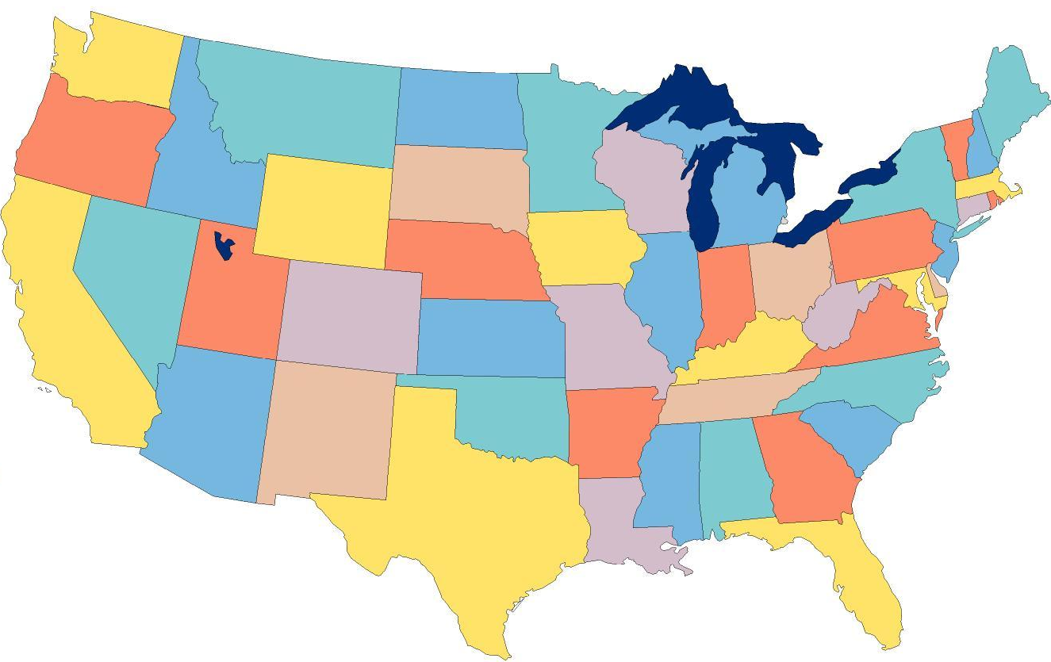
Structured Overlays at 10,000ft.
Node IDs and keys from a randomized namespace
Incrementally route towards to destination ID
Each node knows a small number of IDs + IPs
ABCE
Each node has a routing table
ABC0
Forward to the longest prefix match
To: ABCD
AB5F
A930

Slide 28
Structured Overlay Implementations
Many P2P structured overlay implementations
Generation 1: Chord, Tapestry, Pastry, CAN
Generation 2: Kademlia, SkipNet, Viceroy, Symphony, Koorde, Ulysseus, …
Shared goals and design
Large, sparse, randomized ID space
All nodes choose IDs randomly
Nodes insert themselves into overlay based on ID
Given a key k, overlay deterministically maps k to its root node (a live node in the overlay)

Slide 29
Details
Structured overlay APIs
route(key, msg) : route msg to node responsible for key
Just like sending a packet to an IP address
Distributed hash table (DHT) functionality
put(key, value) : store value at node/key
get(key) : retrieve stored value for key at node
Key questions:
Node ID space, what does it represent?
How do you route within the ID space?
How big are the routing tables?
How many hops to a destination (in the worst case)?

Slide 30
Tapestry/Pastry
Node IDs are numbers in a ring
160-bit circular ID space
Node IDs chosen at random
Messages for key X is routed to live node with longest prefix match to X
Incremental prefix routing
1110: 1XXX→11XX→111X→1110
1111 | 0
To: 1110
0
1110
0010
1100
0100
1010
0110
1000

Slide 31
Physical and Virtual Routing
1111 | 0
To: 1110
1111
0
1110
0010
To: 1110
1100
0100
0010
1100
1010
0110
1010
1000

Slide 32
Problem: Routing Table Size
Definitions:
N is the size of the network
b is the base of the node IDs
d is the number of digits in node IDs
b^{d} = N
If N is large, then a naïve routing table is going to be huge
Assume a flat naming space (kind of like MAC addresses)
A client knows its own ID
To send to any other node, would need to know N-1 other IP addresses
Suppose N = 1 billion :(

Slide 33
Tapestry/Pastry Routing Tables
Incremental prefix routing
Definitions:
N is the size of the network
b is the base of the node IDs
d is the number of digits in node IDs
b^{d} = N
How many neighbors at each prefix digit?
b-1
How big is the routing table?
Total size: b * d
Or, equivalently: b * log_{b} N
log_{b} N hops to any destination
1111 | 0
1110
0
1110
0011
0010
1100
0100
1011
1010
0110
1010
1000
1000

Slide 34
Derivation
Definitions:
N is the size of the network
b is the base of the node IDs
d is the number of digits in node IDs
b^{d} = N
b^{d} can enumerate up to N items
Routing table size is b * d
b^{d} = N
d * log b = log N
d = log N / log b
d = log_{b} N
Thus, routing table is size b * log_{b} N
Key result!
Size of routing tables grows logarithmically to the size of the network
Huge P2P overlays are totally feasible

Slide 35
Routing Table Example
Hexadecimal (base-16), node ID = 65a1fc4
Each x is the IP address of a peer
Row 0
Row 1
d Rows
(d = length of node ID)
Row 2
Row 3

Slide 36
Routing, One More Time
Each node has a routing table
Routing table size:
b * d or b * log_{b} N
Hops to any destination:
log_{b} N
1111 | 0
To: 1110
0
1110
0010
1100
0100
1010
0110
1000

Slide 37
Leaf Sets
Each node has an additional table of the L/2 numerically closest neighbors
Larger and smaller
Uses
Alternate routes
Fault detection (keep-alive)
Replication of data

Slide 38
Joining the Overlay
Pick a new ID X
Contact an arbitrary bootstrap node
Route a message to X, discover the current owner
Add new node to the ring
Download routes from new neighbors, update leaf sets
1111 | 0
0
1110
0010
1100
0100
1010
0110
0011
1000

Slide 39
Node Departure
Leaf set members exchange periodic keep-alive messages
Handles local failures
Leaf set repair:
Request the leaf set from the farthest node in the set
Routing table repair:
Get table from peers in row 0, then row 1, …
Periodic, lazy

Slide 40
DHTs and Consistent Hashing
Mappings are deterministic in consistent hashing
Nodes can leave
Nodes can enter
Most data does not move
Only local changes impact data placement
Data is replicated among the leaf set
1111 | 0
To: 1101
0
1110
0010
1100
0100
1010
0110
1000

Slide 41
Summary of Structured Overlays
A namespace
For most, this is a linear range from 0 to some large number
A mapping from key to node
Chord: keys between node X and its predecessor belong to X
Tapestry/Pastry: keys belong to node w/ closest identifier
CAN: well defined N-dimensional space for each node

Slide 42
Summary, Continued
A routing algorithm
Numeric (Chord), prefix-based (Tapestry/Pastry/Chimera), hypercube (CAN)
Routing state: how much info kept per node
Tapestry/Pastry: b * log_{b}N i^{th} column specifies nodes that match i digit prefix, but differ on (i+1)^{th} digit
Chord: log₂N pointers i^{th} pointer points to MyID+ ( N * (0.5)^{i} )
CAN: 2*d neighbors for d dimensions

Slide 43
Structured Overlay Advantages and Uses
High level advantages
Complete decentralized
Self-organizing
Scalable and (relatively) robust
Applications
Reliable distributed storage
OceanStore (FAST’03), Mnemosyne (IPTPS’02)
Resilient anonymous communication
Cashmere (NSDI’05)
Consistent state management
Dynamo (SOSP’07)
Many, many others
Multicast, spam filtering, reliable routing, email services, even distributed mutexes

Slide 44
Trackerless BitTorrent
Torrent Hash: 1101
1111 | 0
Tracker
0
Leecher
Tracker
1110
0010
Swarm
Initial Seed
1100
0100
1010
0110
1000
Leecher
Initial Seed

