Slide 1
CS 3700
Networks and Distributed Systems
Network Layer
(Putting the Net in Internet)
Revised 1/22/24

Slide 2
Network Layer
Function:
  Route packets end-to-end on a network, through multiple hops
Key challenge:
  How to represent addresses
  How to route packets
    Scalability
    Convergence
Application
Presentation
Session
Transport
Network
Data Link
Physical

Slide 3



Routers, Revisited
How to connect multiple LANs?
LANs may be incompatible
  Ethernet, Wifi, etc…
Connected networks form an internetwork
  The Internet is the best-known example
Routers

Slide 4
Structure of the Internet
Network 3
Network 1
Network 4
Network 2
Ad-hoc interconnection of networks
  No organized topology
  Vastly different technologies, link capacities
Packets travel end-to-end by hopping through networks
  Routers “peer” (connect) different networks
  Different packets may take different routes

Slide 5
Internetworking Issues
Internet Service Model
Best-effort (i.e. things may break)
Store-and-forward datagram network
Lowest common denominator
Naming / Addressing
  How do you designate hosts?
Routing
  Must be scalable (i.e. a switched Internet won’t work)
Service Model
  What gets sent?
  How fast will it go?
  What happens if there are failures?
  Must deal with heterogeneity
    Remember, every network is different

Slide 6
Outline
Addressing
  Class-based
  CIDR
IPv4 Protocol Details
  Packed Header
  Fragmentation
IPv6

Slide 7
Possible Addressing Schemes
Flat
  e.g., each host is identified by a 48-bit MAC address
  Router needs an entry for every host in the world
    Too big
    Too hard to maintain (hosts come and go all the time)
Hierarchy
  Addresses broken down into segments
  Each segment has a different level of specificity

Slide 8
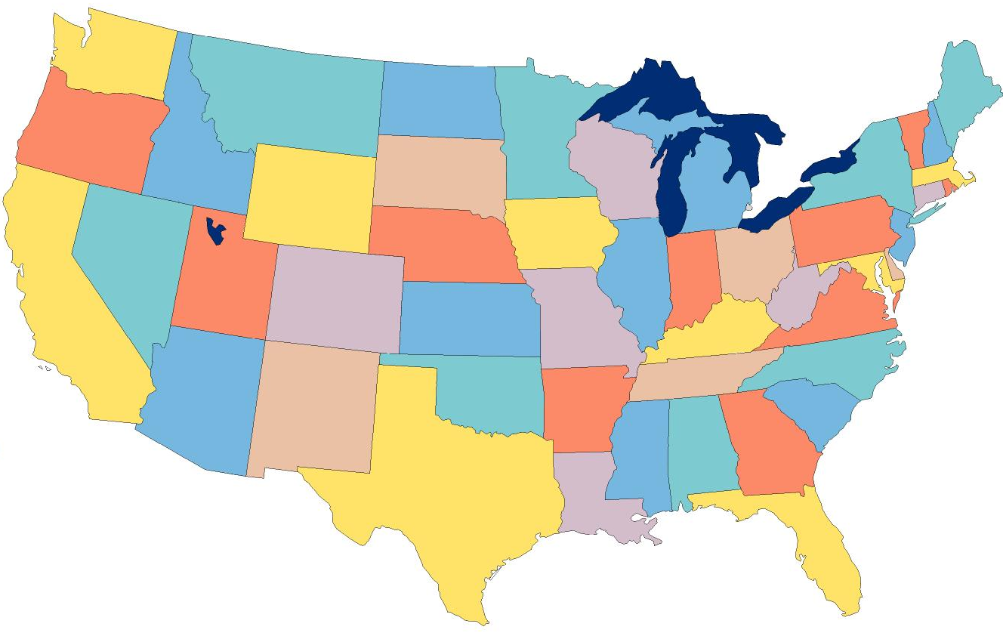
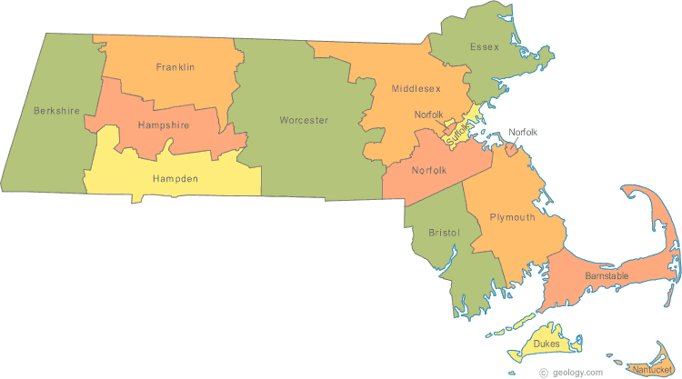

Example: Telephone Numbers
1-617-373-2177
3278
Very General
West Village G
Room 213
West Village H
Room 248
Updates are Local
Very Specific

Slide 9
Binary Hierarchy Example
1**
Datagram, Destination = 101
10*
100
101
11*
0**
110
00*
111
000
001
01*
010
011

Slide 10
IP Addressing
IPv4: 32-bit addresses
  Usually written in dotted notation, e.g., 192.168.21.76
  Each number is a byte
  Stored in Big Endian (Network Byte) order
0
8
16
24
31
Decimal
192
168
21
76
Hex
C0
A8
15
4C
Binary
11000000
10101000
00010101
01001100

Slide 11
IP Addressing and Forwarding
Routing Table Requirements
  For every possible IP, give the next hop
  But for 32-bit addresses, 2³² possibilities!
  Too slow: 4 * 10GE ports needs 176Gbps memory bandwidth
    DRAM is 1-6 Gbps, TCAM is faster but 400x more expensive than DRAM
Hierarchical address scheme
  Separate the address into a network and a host
0
31
Pfx
Network
Host
Known by all routers
Known by edge (LAN) routers

Slide 12
IP Address Naming Hierarchy
Original, Old School Method
Modern Method
Class-based hierarchy
First three bits of the IP address are the prefix
Each prefix denotes:
  Class of network
  Size of the network
  The “name” or prefix of the network
Classless Interdomain Routing (CIDR)

Slide 13
Classes of IP Addresses
0
1
8
16
24
31
Class A
0
Ntwk
Host
Example: MIT
18.*.*.*
1-126
0
2
8
16
24
31
Class B
10
Network
Host
Example: NU
129.10.*.*
128-191
0
3
8
16
24
31
Class C
110
Network
Host
Example:
216.63.78.*
192-223

Slide 14
Two Level Hierarchy
Pfx
Network
Host
…
Subtree size determined by network class
…

Slide 15
Class Sizes
Way too big
Class | Prefix Bits | Network Bits | Number of Classes | Hosts per Class
A | 1 | 7 | 2⁷ – 2 = 126 (0 and 127 are reserved) | 2²⁴ – 2 = 16,777,214 (All 0 and all 1 are reserved)
B | 2 | 14 | 2¹⁴ = 16,398 | 2¹⁶ – 2 = 65,534 (All 0 and all 1 are reserved)
C | 3 | 21 | 2²¹ = 2,097,512 | 2⁸ – 2 = 254 (All 0 and all 1 are reserved)
 |  |  | Total: 2,114,036
Too many network IDs
Too small to be useful

Slide 16
Subnets
Problem: need to break up large A and B classes
Solution: add another layer to the hierarchy
  From the outside, appears to be a single network
    Only 1 entry in routing tables (this becomes an issue)
  Internally, manage multiple subnetworks
    Split the address range using a subnet mask
Subnet Mask is 255.255.192.0
Pfx
Ntwk
Subnet
Host
Subnet Mask:
11111111 11111111 11000000 00000000

Slide 17
Subnet Example
10 means this is a class B network
Class B uses 16 bits total for the network name
IP Address:
10110101 11011101 01010100 01110010
Extract network:
Network Mask:
Subnet mask is 255.255.192.0
& 11111111 11111111 00000000 00000000
Result:
10110101 11011101 00000000 00000000
IP Address:
10110101 11011101 01010100 01110010
Extract subnetwork:
Subnet Mask:
& 11111111 11111111 11000000 00000000
Result:
10110101 11011101 01000000 00000000
IP Address:
10110101 11011101 01010100 01110010
Extract host:
Subnet Mask:
& ~(11111111 11111111 11000000 00000000)
Result:
00000000 00000000 00010100 01110010

Slide 18
N-Level Subnet Hierarchy
Pfx
Network
Subnet
Host
…
Tree does not have a fixed depth
Increasingly specific subnet masks
…
Subtree size determined by length of subnet mask
…

Slide 19
Example Routing Table
Address Prefix | Subnet Mask | Prefix After Masking (in Binary) | Next Hop
0.0.0.0 | 0.0.0.0 | ******** ******** ******** ******** | Port 4
18.0.0.0 | 255.0.0.0 | 00010010 ******** ******** ******** | Port 2
128.42.0.0 | 255.255.0.0 | 10000000 00101010 ******** ******** | Port 3
128.42.128.0 | 255.255.128.0 | 10000000 00101010 1******* ******** | Port 5
128.42.222.0 | 255.255.255.0 | 10000000 00101010 11011110 ******** | Port 1
Question: 128.42.222.198 matches four rows
  Which router do we forward to?
Longest prefix matching
  Use the row with the longest number of 1’s in the mask
  This is the most specific match

Slide 20
Subnetting Revisited
Question: does subnetting solve all the problems of class-based routing?
NO
Classes are still too coarse
  Class A can be subnetted, but only 126 available
    e.g., company w/ a Class A and subnets to multiple locations has only 1 routing table entry
  Class C is too small
  Class B is nice, but there are only 16,398 available
Routing tables are still too big
  2.1 million entries per router

Slide 21
IP Address Naming Hierarchy
Original, Old School Method
Modern Method
Class-based hierarchy
First three bits of the IP address are the prefix
Each prefix denotes:
  Class of network
  Size of the network
  The “name” or prefix of the network
Classless Interdomain Routing (CIDR)
Each network is assigned a bitmask
The bitmask separates the network “name” portion of the IP address from the host portion

Slide 22
Classless Inter Domain Routing
CIDR, pronounced ‘cider’
Key ideas:
  Get rid of IP classes
  Use bitmasks for all levels of routing
  Aggregation to minimize FIB (Forwarding Information Base)
Arbitrary split between network and host
  Specified as a bitmask or prefix length
  Example: Northeastern
    129.10.0.0 with netmask 255.255.0.0
    129.10.0.0 / 16

Slide 23
Example CIDR Routing Table
Prefix | Netmask | Prefix After Masking (in Binary) | IP Address Range
207.46.0.0 | 19 | 11001111 00101110 000***** ******** | 207.46.0 – 31.*
207.46.32.0 | 19 | 11001111 00101110 001***** ******** | 207.46.32 – 63.*
207.46.64.0 | 19 | 11001111 00101110 010***** ******** | 207.46.64 – 95.*
207.46.128.0 | 18 | 11001111 00101110 10****** ******** | 207.46.128 – 191.*
207.46.192.0 | 18 | 11001111 00101110 11****** ******** | 207.46.192 – 255.*
Hole in the Routing Table: No coverage for 96 – 127
Missing entry: 207.46.96.0/19

Slide 24
Aggregation with CIDR
Original use: aggregating class C ranges
One organization given contiguous class C ranges
  Example: Microsoft, 207.46.192.* – 207.46.255.*
  Represents 2⁶ = 64 class C ranges
  Specified as CIDR address 207.46.192.0/18
0
8
16
24
31
Decimal
207
46
192
0
Hex
CF
2E
C0
00
Binary
11001111
00101110
11xxxxxx
xxxxxxxx
18 Bits Frozen By Netmask
14 Arbitrary Bits

Slide 25
CIDR Aggregation Example
Same length netmask
All bits match except for the last one
Same port
Prefix | Netmask | Prefix After Masking (in Binary) | Next Hop
207.46.0.0 | 19 | 11001111 00101110 000***** ******** | Port 1
207.46.32.0 | 19 | 11001111 00101110 001***** ******** | Port 1
207.46.64.0 | 18 | 11001111 00101110 01****** ******** | Port 1
207.46.128.0 | 18 | 11001111 00101110 10****** ******** | Port 2
207.46.192.0 | 18 | 11001111 00101110 11****** ******** | Port 3
207.46.0.0
18
11001111 00101110 00****** ********
Port 1
207.46.0.0
17
11001111 00101110 0******* ********
Port 1
Aggregation allows multiple routes to be compressed together to shrink the size of the routing table

Slide 26
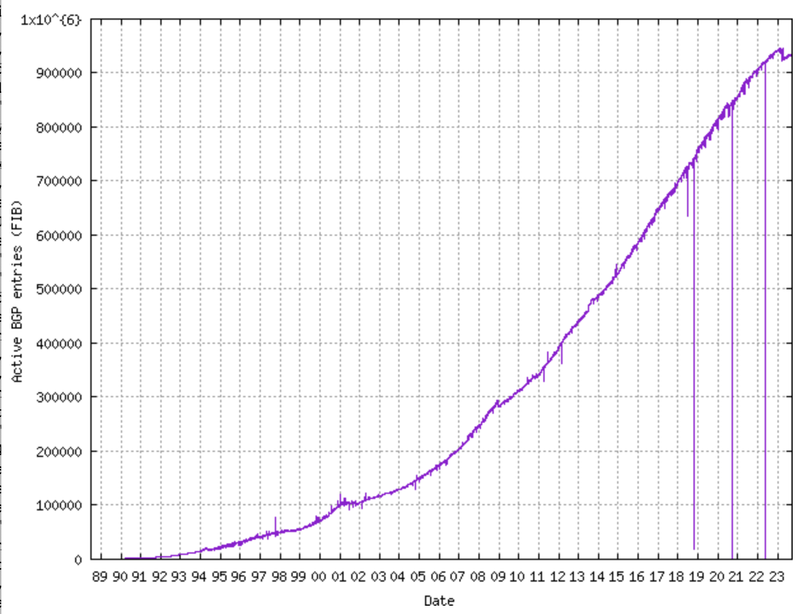
Size of CIDR Routing Tables
From www.cidr-report.org
CIDR has kept IP routing table sizes in check
  Currently ~900,000 entries for a complete IP routing table
  Only required by backbone routers

Slide 27
Takeaways
Hierarchical addressing is critical for scalability
  Not all routers need all information
  Limited number of routers need to know about changes
Non-uniform hierarchy useful for heterogeneous networks
  Class-based addressing is too course
  CIDR improves scalability and granularity
Implementation challenges
  Longest prefix matching is more difficult than schemes with no ambiguity

Slide 28

How Do You Get IPs?
IP address ranges controlled by IANA
  Internet Assigned Number Authority
  Roots go back to 1972, ARPANET, UCLA
  Today, part of ICANN
IANA grants IPs to regional authorities
  ARIN (American Registry of Internet Numbers) may grant you a range of IPs
  You may then advertise routes to your new IP range
  There are now secondary markets, auctions, …

Slide 29
Outline
Addressing
  Class-based
  CIDR
IPv4 Protocol Details
  Packed Header
  Fragmentation
IPv6

Slide 30
IP Datagrams
IP Datagrams are like a letter
  Totally self-contained
  Include all necessary addressing information
  No advanced setup of connections or circuits
0
4
8
12
16
19
24
31
Version
HLen
DSCP/ECN
Datagram Length
Identifier
Flags
Offset
TTL
Protocol
Checksum
Source IP Address
Destination IP Address
Options (if any, usually not)
Data

Slide 31
IP Header Fields: Word 1
Version: 4 for IPv4
Header Length: Number of 32-bit words (usually 5)
Type of Service: Priority information (unused)
Datagram Length: Length of header + data in bytes
0
4
8
12
16
19
24
31
Version
HLen
DSCP/ECN
Datagram Length
Identifier
Flags
Offset
TTL
Protocol
Checksum
Limits packets to 65,535 bytes
Source IP Address
Destination IP Address
Options (if any, usually not)
Data

Slide 32
IP Header Fields: Word 3
Time to Live: decremented by each router
  Used to kill looping packets
Protocol: ID of encapsulated protocol
  6 = TCP, 17 = UDP
Checksum
0
4
8
12
16
19
24
31
Version
HLen
DSCP/ECN
Datagram Length
Identifier
Flags
Offset
TTL
Protocol
Checksum
Source IP Address
Used to implement trace route
Destination IP Address
Options (if any, usually not)
Data

Slide 33
IP Header Fields: Word 4 and 5
Source and destination address
  In theory, must be globally unique
  In practice, this is often violated
0
4
8
12
16
19
24
31
Version
HLen
DSCP/ECN
Datagram Length
Identifier
Flags
Offset
TTL
Protocol
Checksum
Source IP Address
Destination IP Address
Options (if any, usually not)
Data

Slide 34
Problem: Fragmentation
MTU = 4000
MTU = 2000
MTU = 1500
Datagram
Dgram1
Dgram2
1
2
3
4
Problem: each network has its own Maximum Transmission Unit (MTU)
  DARPA principles: networks allowed to be heterogeneous
  Minimum MTU may not be known for a given path
IP Solution: fragmentation
  Split datagrams into pieces when MTU is reduced
  Reassemble original datagram at the receiver

Slide 35
IP Header Fields: Word 2
Identifier: a unique number for the original datagram
Flags: M flag, i.e. this is the last fragment
Offset: byte position of the first byte in the fragment
  Divided by 8
0
4
8
12
16
19
24
31
Version
HLen
TOS
Datagram Length
Identifier
Flags
Offset
TTL
Protocol
Checksum
Source IP Address
Destination IP Address
Options (if any, usually not)
Data

Slide 36
Fragmentation Example
MTU = 4000
MTU = 2000
MTU = 1500
Length = 1996, M = 1,
ID=123, Offset = 0
IP
Data
ID = 123 Length = 3820, M = 0
1976
+ 1824
= 3800
20
1976
IP Hdr
Data
20
3800
Length = 1844, M = 0,
ID = 123, Offset = 247
Why 247? Offset is the previous length divided by 8
IP
Data
20
1824

Slide 37
Fragmentation Example
MTU = 2000
MTU = 1500
Length = 1996, M = 1,
ID = 123, Offset = 0
Length = 1500, M = 1,
ID = 123, Offset = 0
IP
Data
IP
Data
Length = 1500, M = 1,
ID = 123, Offset = 247
20
1976
20
1480
IP
Data
Length = 516, M = 1,
ID = 123, Offset = 185
20
1480
1480
+ 496
= 1976
Length = 1844, M = 0,
ID = 123, Offset = 247
IP
Data
Length = 364, M = 0,
ID = 123, Offset = 432
IP
Data
20
496
IP
Data
20
1824
20
344

Slide 38
IP Fragment Reassembly
Length = 1500, M = 1, ID = 123, Offset = 0
Performed at destination
All fragments with matching IDs belong together
  Sort them by offset for reconstruction
M = 0 fragment gives us total data size
  364 – 20 + 432 * 8 = 3800
Challenges:
  Out-of-order fragments
  Missing fragments
  Duplicate fragments
  Overlapping fragments
Basically, memory management nightmare
IP
Data
20
1480
Length = 516, M = 1, ID = 123, Offset = 185
IP
Data
20
496
Length = 1500, M = 1, ID = 123, Offset = 247
IP
Data
20
1480
Length = 364, M = 0, ID = 123, Offset = 432
IP
Data
20
344

Slide 39
Fragmentation Concepts
Highlights many key Internet characteristics
  Decentralized and heterogeneous
    Each network may choose its own MTU
  Connectionless datagram protocol
    Each fragment contains full routing information
    Fragments can travel independently, on different paths
  Best effort network
    Routers/receiver may silently drop fragments
    No requirement to alert the sender
  Most work is done at the endpoints
    i.e. reassembly

Slide 40
Fragmentation in Reality
Fragmentation is expensive
  Memory and CPU overhead for datagram reconstruction
  Want to avoid fragmentation if possible
MTU discovery protocol
  Send a packet with “don’t fragment” bit set
  Keep decreasing message length until one arrives
  May get “can’t fragment” error from a router, which will explicitly state the supported MTU
Router handling of fragments
  Fast, specialized hardware handles the common case
  Dedicated, general purpose CPU just for handling fragments

Slide 41
Fragmentation Exercise
Length = 1196, M = 1,
ID=123, Offset = 0
MTU = 2500
MTU = 1200
IP
Data
20
1176
1176
+ 1176
+ 48
= 2400
Length = 1196, M = 1,
ID = 123, Offset = 147
ID = 123 Length = 2420, M = 0
IP Hdr
Data
IP
Data
20
2400
20
1176
Length = 68, M = 0,
ID = 123, Offset = 294
IP
Data
20
48

Slide 42
Outline
Addressing
  Class-based
  CIDR
IPv4 Protocol Details
  Packed Header
  Fragmentation
IPv6

Slide 43
The IPv4 Address Space Crisis
Problem: the IPv4 address space is too small
  2³² = 4,294,967,296 possible addresses
  Less than one IP per person
We have run out of IPv4 addresses
  IANA assigned the last /8 block of addresses in 2011
Region | Regional Internet Registry (RIR) | Exhaustion Date
Asia/Pacific | APNIC | April 19, 2011
Europe/Middle East | RIPE | November 25, 2019
South America | LACNIC | August 21, 2020
North America | ARIN | September 22, 2015
Africa | AFRINIC | January 2022

Slide 44
IPv6
IPv6, first introduced in 1998
  128-bit addresses
  4.8 * 10²⁸ addresses per person
Address format
  8 groups of 16-bit values, separated by ‘:’
  Leading zeroes in each group may be omitted
  Groups of zeroes can be omitted using ‘::’
  2001:0db8:0000:0000:0000:ff00:0042:8329
  2001:0db8:0:0:0:ff00:42:8329
  2001:0db8::ff00:42:8329

Slide 45
IPv6 Trivia
Who knows the IP for localhost?
  127.0.0.1
What is localhost in IPv6?
  ::1

Slide 46
IPv6 Header
Double the size of IPv4 (320 bits vs. 160 bits)
0
4
8
12
16
19
24
31
Version
DSCP/ECN
Flow Label
Datagram Length
Next Header
Hop Limit
Version = 6
Same as IPv4
Groups packets into flows, used for QoS
Source IP Address
Same as IPv4
Same as Protocol in IPv4
Same as TTL in IPv4
Destination IP Address

Slide 47
Differences from IPv4 Header
Several header fields are missing in IPv6
  Header length – rolled into Next Header field
  Checksum – was useless, so why keep it
  Identifier, Flags, Offset
    IPv6 routers do not support fragmentation
    Hosts are expected to use path MTU discovery
Reflects changing Internet priorities
  Today’s networks are more homogeneous
  Instead, routing cost and complexity dominate
No security vulnerabilities due to IP fragments

Slide 48
Performance Improvements
No checksums to verify
No need for routers to handle fragmentation
Simplified routing table design
  Address space is huge
  Different role for CIDR
  Standard subnet size is 2⁶⁴ addresses
Simplified auto-configuration
  Neighbor Discovery Protocol
  Used by hosts to determine network ID
  Host ID can be random!

Slide 49
Deployment Challenges
HTTP, FTP, SMTP, RTP, IMAP, …
TCP, UDP, ICMP
IPv4
Ethernet, 802.11x, DOCSIS, …
Fiber, Coax, Twisted Pair, Radio, …
Switching to IPv6 is a whole-Internet upgrade
  All routers, all hosts
  ICMPv6, DHCPv6, DNSv6
June 2012: 0.2% of global traffic was IPv6; Today ~33%

Slide 50
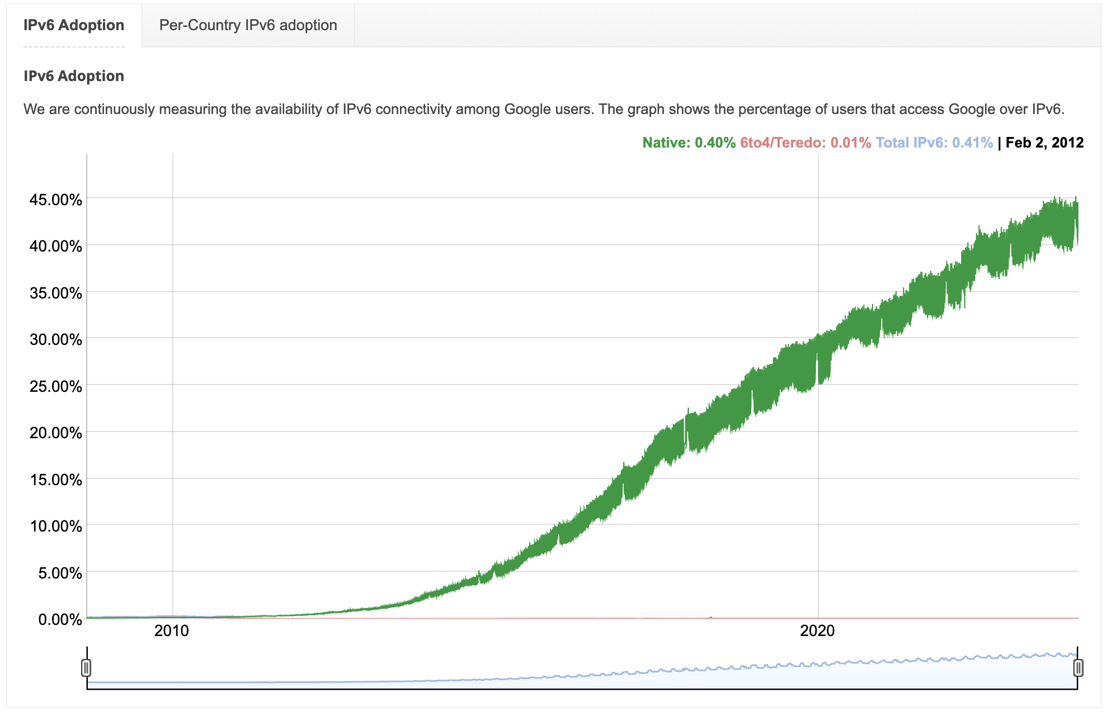
IPv6 Growth seen from Google
Notes:
https://www.google.com/intl/en/ipv6/statistics.html

Slide 51
Consequences of IPv6
Beware unintended consequences of IPv6
Example: IP blocklists
  Currently, blocklists track IPs of spammers/bots
  Few IPv4 addresses mean list sizes are reasonable
  Hard for spammers/bots to acquire new IPs
Blocklists will not work with IPv6
  Address space is enormous
  Acquiring new IP addresses is trivial

Slide 52
Additional IPv6 Features
Source Routing
  Host specifies the route to wants packet to take
Mobile IP
  Hosts can take their IP with them to other networks
  Use source routing to direct packets
Privacy Extensions
  Randomly generate host identifiers
  Make it difficult to associate one IP to a host
Jumbograms
  Support for 4Gb datagrams

Slide 53

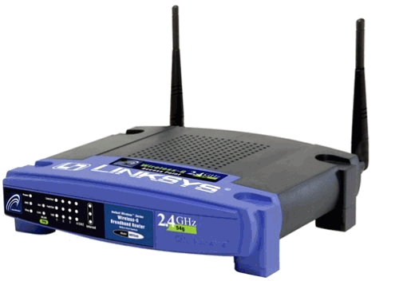
Transitioning to IPv6
How do we ease the transition from IPv4 to IPv6?
  Today, most network edges are IPv6 ready
    Windows/OSX/iOS/Android all support IPv6
    Your wireless access point probably supports IPv6
  The Internet core is hard to upgrade
  … but a IPv4 core cannot route IPv6 traffic
IPv6 Ready
IPv4 Only :(
IPv6 Ready
IPv6 Packets
Home
Network
Core
Internet
Business
Network

Slide 54
Transition Technologies
How do you route IPv6 packets over an IPv4 Internet?
Transition Technologies
  Use tunnels to encapsulate and route IPv6 packets over the IPv4 Internet
  Several different implementations
    6to4
    IPv6 Rapid Deployment (6rd)
    Teredo
    … etc.

Slide 55
6to4 Basics
Problem: you’ve been assigned an IPv4 address, but you want an IPv6 address
  Your ISP can’t or won’t give you an IPv6 address
  You can’t just arbitrarily choose an IPv6 address
Solution: construct a 6to4 address
  6to4 addresses always start with 2002::
  Embed the 32-bit IPv4 inside the 128-bit IPv6 address
IPv4:
207.
46.
192.
0
IPv6:
20 02:
CF 2E:
C0 00:
0000

Slide 56
Routing from 6to4 to 6to4
How does a host using 6to4 send a packet to another host using 6to4?
Dest: 16.79.8.0
Dest: 2002:104F:0800::
IPv4
Internet
IPv4 – 207.46.192.0
IPv6 – 2002:CF2E:C000::
IPv4 – 16.79.8.0
IPv6 – 2002:104F:0800::

Slide 57
Routing from 6to4 to Native IPv6
Special, anycasted IPv4 address for
6to4 Relay Routers
Dest: 192.88.99.1
Dest: 1893:92:13:99::
IPv4
Internet
IPv4 – 192.88.99.1
IPv6 – 2002:: /16
IPv4 – 207.46.192.0
IPv6 – 2002:CF2E:C000::
IPv6
Internet
Many ISPs provide 6to4 relay routers
IPv6 – 1893:92:13:99::

Slide 58
Routing from Native IPv6 to 6to4
IPv4
Internet
Dest: 207.46.192.0
IPv4 – 192.88.99.1
IPv6 – 2002:: /16
IPv4 – 207.46.192.0
IPv6 – 2002:CF2E:C000::
IPv6
Internet
Dest: 2002:CF2E:C000::
Use normal IPv6 routing to reach a 6to4 relay router
IPv6 – 1893:92:13:99::

Slide 59
Problems with 6to4
Uniformity
  Not all ISPs have deployed 6to4 relays
Quality of service
  Third-party 6to4 relays are available
  …but, they may be overloaded or unreliable
Reachability
  6to4 doesn’t work if you are behind a NAT
Possible solutions
  IPv6 Rapid Deployment (6rd)
    Each ISP sets up relays for its customers
    Does not leverage the 2002:: address space
  Teredo
    Tunnels IPv6 packets through UDP/IPv4 tunnels
    Can tunnel through NATs, but requires special relays

Slide 60
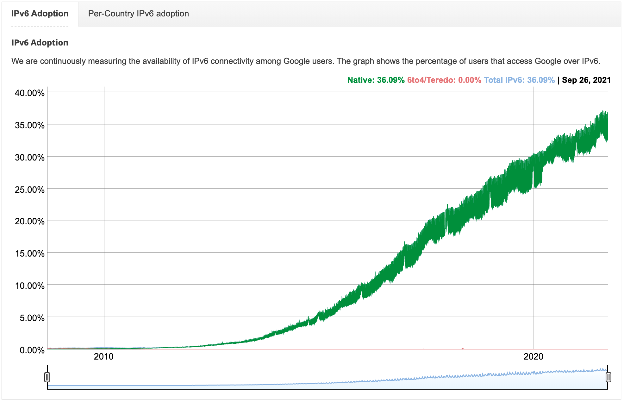
What transition technologies do we see today?
Why?
Widespread prevalence of dual stacks

