Slide 1
CS 3700 Networks and Distributed Systems
Inter Domain Routing
(It’s all about the Money)
Revised 10/6/22

Slide 2
Network Layer, Control Plane
Function:
Set up routes between networks
Key challenges:
Implementing provider policies
Creating stable paths
Data Plane
Application
Presentation
Session
Transport
Network
RIP
OSPF
BGP
Control Plane
Data Link
Physical

Slide 3
Internet Routing
Internet organized as a two-level hierarchy
First level – autonomous systems (AS’s)
AS – region of network under a single administrative domain
Examples: Comcast, AT&T, Verizon, T-Mobile, etc.
AS’s use intra-domain routing protocols internally
Distance Vector, e.g., Routing Information Protocol (RIP)
Link State, e.g., Open Shortest Path First (OSPF)
Connections between AS’s use inter-domain routing protocols
Border Gateway Routing (BGP)
De facto standard today, BGP-4

Slide 4
ASs, Revisited
AS-1
AS-3
Interior Routers
AS-2
BGP Routers

Slide 5
Why Do We Have ASs?
History – the Internet started as a network of networks
Routing algorithms are not efficient enough to execute on the entire Internet topology
Different organizations may use different routing policies
Allows organizations to hide their internal network structure
Allows organizations to choose how to route across each other (BGP)
Easier to compute routes
Greater flexibility
More autonomy/independence

Slide 6
AS Numbers
Each AS identified by an ASN number
Originally 16-bit values, expanded to 32 bits in 2006
1023 are reserved for local/private use, 3 reserved for special use
Currently, there are ~ 73932 advertised ASNs http://www.potaroo.net/tools/asn32/
AT&T: 5074, 6341, 7018, …
Sprint: 1239, 1240, 6211, 6242, …
Northeastern: 156
North America ASs → https://ftp.arin.net/info/asn.txt

Slide 7
Inter-Domain Routing
Global connectivity is at stake!
Thus, all ASs must use the same protocol
Contrast with intra-domain routing
What are the requirements?
Scalability
Flexibility in choosing routes
Cost
Routing around failures
BGP is a Path Vector protocol
BGP includes path information in protocol messages

Slide 8
BGP
Border Gateway Protocol
De facto inter-domain protocol of the Internet
Policy based routing protocol
Uses a Bellman-Ford path vector protocol
Relatively simple protocol, but…
Complex, manual configuration
Entire world sees advertisements
Errors can screw up traffic globally
Policies driven by economics
How much $$$ does it cost to route along a given path?
Not by performance (e.g. shortest paths)

Slide 9
BGP Relationships
Provider
Peer 2 has no incentive to route 1→ 3
Peers do not pay each other
Customer
Provider
Customer
Peer 1
Peer 2
Peer 3
Customer pays provider
Customer

Slide 10
Tier-1 ISP Peering
NTT
Centurylink
Deutsche Telekom
AT&T
Orange
Sprint
Verizon Enterprise

Slide 11
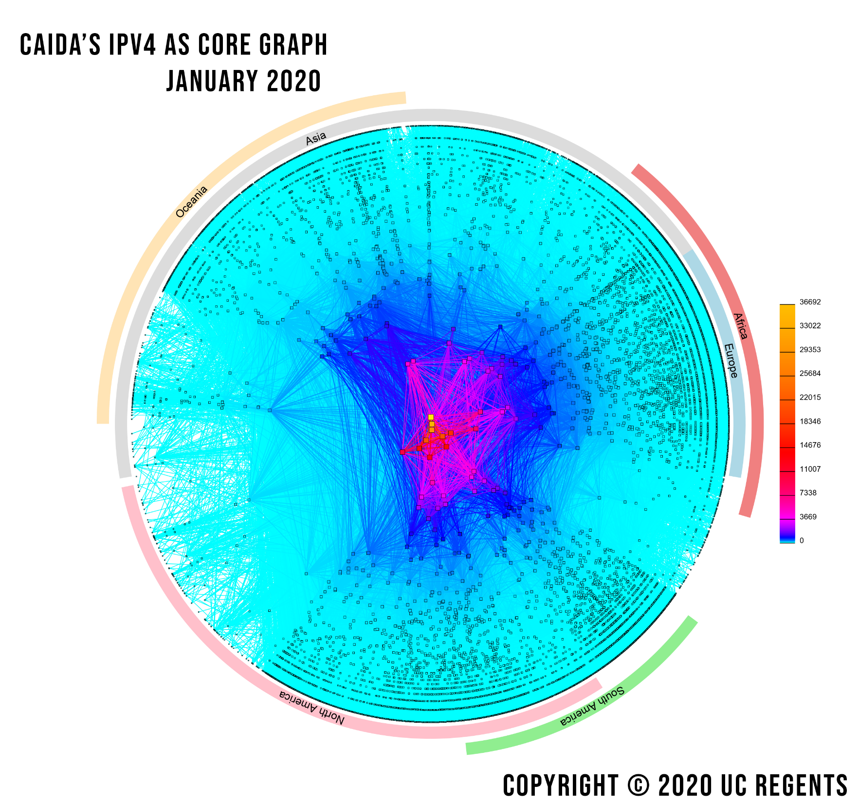
Notes:
From https://www.caida.org/projects/as-core/pics/2020/ascore-2020-ipv4-standalone.png

Slide 12
Peering Wars
Peer
Don’t Peer
Reduce upstream costs
Improve end-to-end performance
May be the only way to connect to parts of the Internet
You would rather have customers
Peers are often competitors
Peering agreements require periodic renegotiation
Peering struggles in the ISP world are extremely contentious, agreements are usually confidential

Slide 13
Two Types of BGP Neighbors
Exterior routers also speak IGP
IGP
eBGP
eBGP
iBGP
iBGP

Slide 14
Full iBGP Meshes
eBGP
iBGP
Question: why do we need iBGP?
OSPF does not include BGP policy info
Prevents routing loops within the AS
iBGP updates do not trigger announcements

Slide 15
Path Vector Protocol
AS-path: sequence of ASs a route traverses
Similar to distance vector, but sends the entire path
Used for loop detection and to apply policy
If you see your own ID in an advertisement, discard it
Default choice: route with fewest # of ASs
AS 4
120.10.0.0/16: AS4
120.10.0.0/16
120.10.0.0/16: AS 3 → AS4
AS 3
130.10.0.0/16
AS 5
120.10.0.0/16: AS2 → AS 3 → AS4
AS 2
110.10.0.0/16
120.10.0.0/16: AS 2 → AS 3 → AS 4
130.10.0.0/16: AS 2 → AS 3
110.10.0.0/16: AS 2 → AS 5
AS 1

Slide 16
BGP Operations (Simplified)
Establish session on TCP port 179
AS-1
Exchange active routes
BGP Session
AS-2
Exchange incremental updates

Slide 17
Four Types of BGP Messages
Open: Establish a peering session.
Keep Alive: Handshake at regular intervals.
Notification: Shuts down a peering session.
Update: Announce new routes or withdraw previously announced routes.
announcement = IP prefix + attributes values

Slide 18
CS 3700 ECON 3700 Networks and Distributed Systems
Inter Domain Routing
(It’s all about the Money)
Revised 9/2/21

Slide 19
BGP Attributes
Some attributes used to select “best” path
LocalPref
Local preference policy to choose most preferred route
Overrides default fewest AS behavior
Multi-exit Discriminator (MED)
Chooses peering point for your network
Specifies path for external traffic destined for an internal network
Other attributes control how routes are shared with others
Import Rules
What route advertisements do I accept?
Export Rules
Which routes do I forward to whom?

Slide 20
Route Selection Summary
Highest Local Preference
Enforce relationships
Shortest AS Path
Lowest MED
Traffic engineering
Lowest IGP Cost to BGP Egress
When all else fails,
break ties
Lowest Router ID

Slide 21
Shortest AS Path != Shortest Path
4 hops
4 ASs
9 hops
2 ASs
Source
?
?
Destination

Slide 22
Hot Potato Routing
5 hops total, 2 hops cost
Source
3 hops total,
3 hops cost
?
?
Destination

Slide 23
Importing Routes
From Provider
ISP Routes
From Peer
From Peer
From Customer

Slide 24
Exporting Routes
$$$ generating routes
Customer and ISP routes only
To Provider
To Peer
To Peer
To Customer
Customers get all routes

Slide 25
AS Relationships: It’s Complicated
Typical models of AS relationships are simple
Each AS pair has exactly one relationship
Each relationship is the same for all prefixes
Unfortunately, in practice it’s much more complicated
Widespread regional, per-prefix peerings
Tier-1’s being shoved out by “hypergiant” content providers
Internet Exchange Points (IXPs) dominating traffic volume

Slide 26
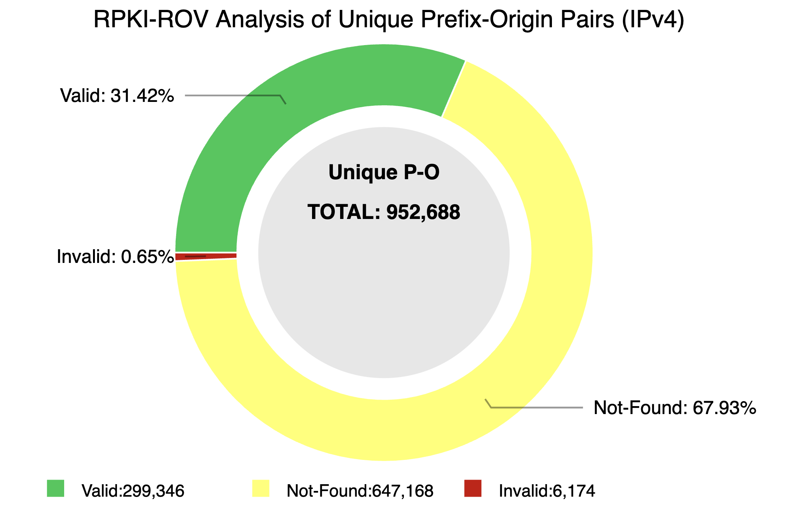
BGP Security
BGP is insecure by default
Any trusted BGP router may announce any route
Prefix hijacking is entirely possible
Examples
2008: YouTube accidentally blocked globally by an ISP in Pakistan
2022: KLAYswap crypto phishing attack in South Korea
Resource Public Key Infrastructure (RPKI)
All route announcements are cryptographically signed
Public binding between cryptographic keys and prefixes
However, only ~30% adoption so far

Slide 27
CS 3700 Networks and Distributed Systems
Bonus: Recent outage
Revised 9/2/21

Slide 28
The Outage
Gather round, we’ll cover an event, quite sober
One that took place on the fourth of October
Facebook, Insta, and friends couldn’t be reached
Rumors spread that the service was breached
At the datacenter keycards were denied
In fact, all the recovery systems were fried
At last, on doors angle grinders were employed
To fix a network config erroneously deployed
Six hours of downtime committed to lore:
For Facebook was thwarted by BGP4

Slide 29
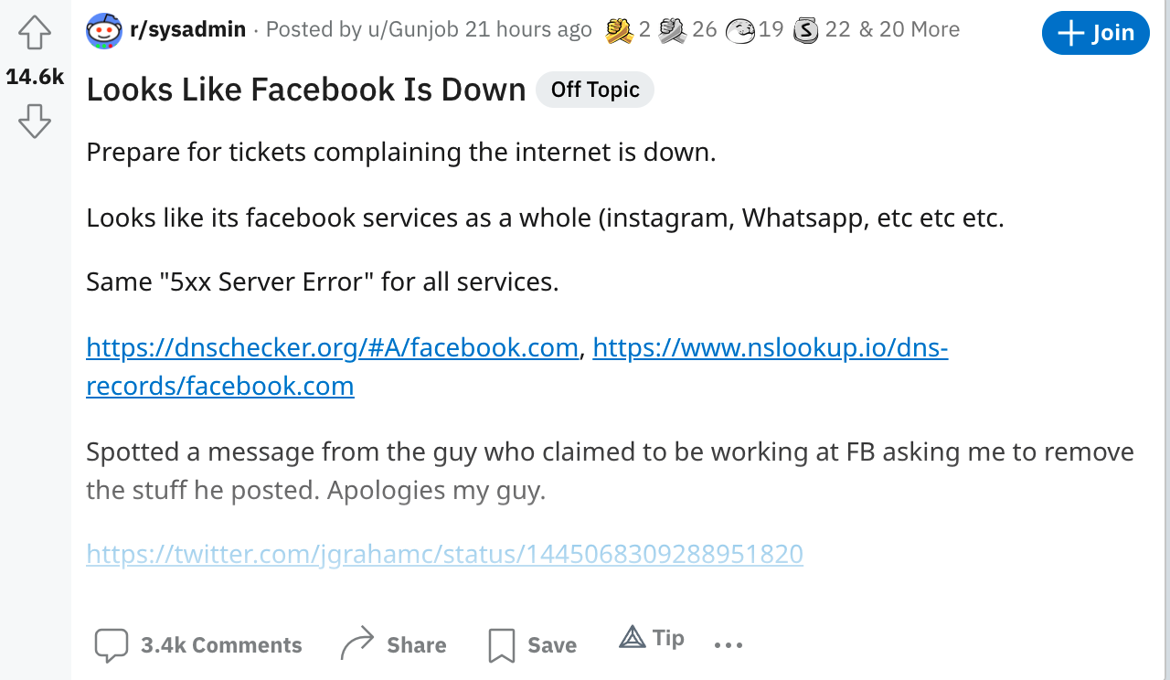
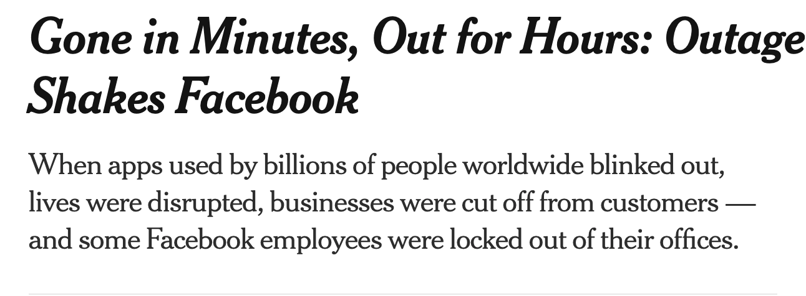
Ripped from the headlines

Slide 30
What happened?
15:39 UTC: Routes to Facebook became unavailable
Shortly thereafter: DNS entries timed out, lookups failed
Remote access to datacenters went down
Engineers deployed to datacenters to fix
Keycard authentication relied on systems that were down
Communication with people with keys went down
Angle grinders were acquired
20:50 UTC: Routes re-established
21:05 UTC: DNS started working

Slide 31
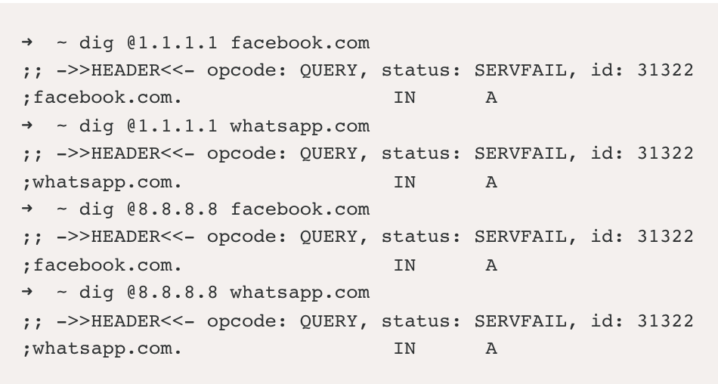
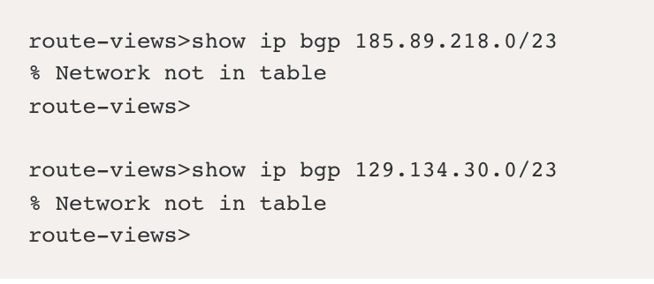
Diagnosing an outage
FB, Insta, WhatsApp down
Was it DNS?
Wait, DNS is unreachable?
No routing table entries?
Could it be … BGP?

Slide 32
How routing tables are populated
185.89.218.0/23: Comcast L3 ATT FB
185.89.218.0/23: L3 ATT FB
NU
Lumen
Comcast
185.89.218.0/23: ATT FB
L3
185.89.218.0/23: GTT VZ FB
185.89.218.0/23: GTT VZ FB
Charter
GTT
ATT
185.89.218.0/23: FB
Tata
185.89.218.0/23: VZ FB
185.89.218.0/23: FB
Sprint
FB
Verizon
FB backbone
185.89.218.0/23: FB

Slide 33
How routing tables adapt to outages
185.89.218.0/23: Comcast L3 ATT FB
185.89.218.0/23: L3 ATT FB
NU
Lumen
Comcast
185.89.218.0/23: ATT FB
L3
185.89.218.0/23: GTT VZ FB
185.89.218.0/23: GTT VZ FB
Charter
185.89.218.0/23: Comcast L3 ATT FB
GTT
ATT
185.89.218.0/23: FB
Tata
185.89.218.0/23: VZ FB
185.89.218.0/23: FB
Sprint
FB
Verizon
FB backbone
185.89.218.0/23: FB

Slide 34
The great withdrawal

Slide 35
The great withdrawal

Slide 36
Root cause?

Slide 37
Lessons learned
Vint Cerf: Internet is resilient to a nuclear holocaust
Reality: Centralization among hypergiants reduces resilience
Layering: Great for modularity Reality: A house of cards
Automation: Great way to avoid human error Reality: When mistakes happen, scale can be astronomical
FB SWEs: Boatloads of talent Reality: We all make mistakes, some of them bigger than others

Slide 38
Bonus Round: Network Neutrality

Slide 39
Hush-a-phone – noise muffler for telephones
Subject of the landmark Hush-a-phone v. US court case of 1956

Slide 40
Common Carriers
In exchange for monopoly over a physical resource, the owner of the resource must provide access to all (reasonable, legal) takers
Telecommunications companies, e.g., AT&T
Oil pipeline providers
Freight and logistics companies
What about the internet?

Slide 41
US FCC Classifications
Title I – information services
Netflix, E-mail, SMS, etc.
Title II – common carriers
Historically applied to telephone companies
ISPs were regulated under Title I until 2015, then Title II
Switched back to Title I in 2018

Slide 42
Why Does Classification Matter?
Blocking and throttling
In the ‘90s and early 2000’s, ISPs routinely blocked apps like BitTorrent
Cell network ISPs routinely slow down audio and video streams to force them to lower quality
Paid prioritization
Cell networks charge extra for access to high-quality streaming video
ISPs have demanded huge fees from content providers like Netflix
Zero rating
AT&T lets you stream HBO Max (when it was owned by AT&T) at high-quality without impacting your monthly data limit
Facebook subsidizes internet access in developing countries, but only for Facebook services

Slide 43
Network Neutrality
Coined by Columbia Law professor Tim Wu
“All Internet traffic should be treated equally”
Dumb pipes – ISPs provide packet delivery and that is it

Slide 44
Net Neutrality Rules
No blocking
ISP cannot arbitrarily censor websites, content, packets, etc.
Except to comply with other laws, e.g. copyright and anti-child porn, etc.
No throttling
ISP cannot arbitrarily slow down particular services
Exceptions for “reasonable network management”, cybersecurity, etc.
No paid prioritization
ISP cannot charge service providers for improved access to customers
No zero rating
ISP cannot give preference to some services by making them “free”
E.g. exempting a service from monthly data usage limits

Slide 45
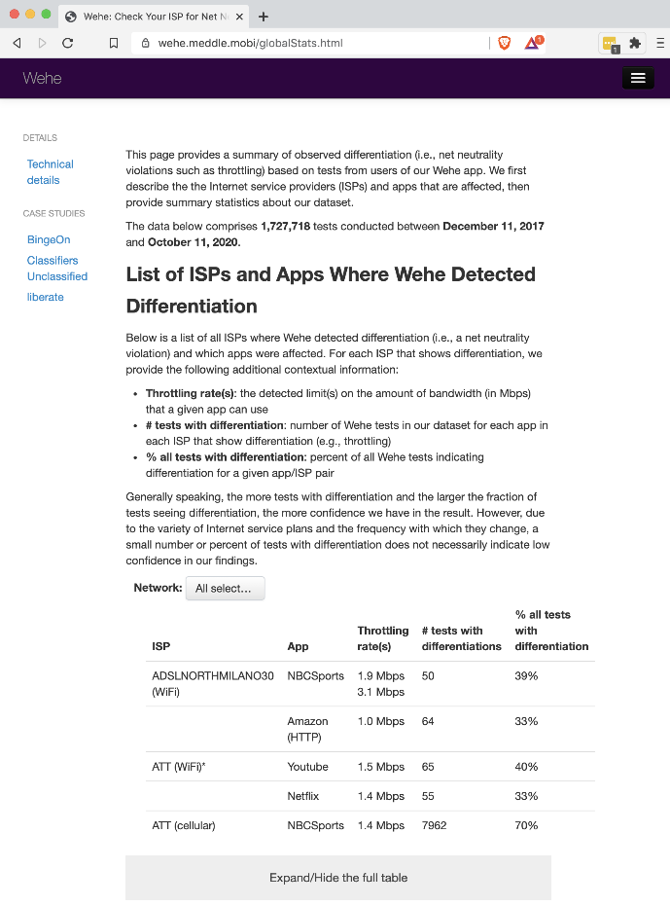
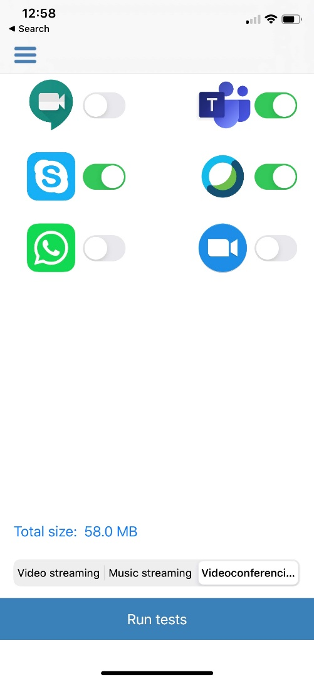
Measuring Net Neutrality Violations
Wehe app (iOS, Android)
Developed at NU
More than 2M tests to date
Nearly all US cell providers throttle video
Not all video is throttled
YouTube almost always is
Vimeo less so
For more info, see wehe.meddle.mobi
Run tests
Play with public dataset

