Slide 1
CS 4700 / 5700 Network Fundamentals
DNS Privacy and Security
Revised 10/3/2024

Slide 2
Outline
DNS Privacy
Attacking DNS
DNS Security

Slide 3
DNS Resolution Example
www.google.com
Where is www.google.com?
TxID: 12347
Q: 1 | A: 1
Auth: 0 | Addl: 0
Q: Where is www.google.com?
A www.google.com 182.0.7.34
TxID: 12347
Q: 1 | A: 0
Auth: 0 | Addl: 0
Q: Where is www.google.com?
TxID: 12346
Q: 1 | A: 0
Auth: 0 | Addl: 0
Q: Where is www.google.com?
TxID: 12345
Q: 1 | A: 0
Auth: 0 | Addl: 0
Q: Where is www.google.com?
asgard.ccs.neu.edu
ns1.google.com
TxID: 12345
Q: 1 | A: 0
Auth: 1 | Addl: 1
Q: Where is www.google.com?
Auth: NS a.gtld-server.com
Addl: A a.gtld-server.com 12.56.10.1
TxID: 12346
Q: 1 | A: 0
Auth: 1 | Addl: 1
Q: Where is www.google.com?
Auth: NS ns1.google.com
Addl: A ns1.google.com 8.8.0.1
a.gtld-server.com
Root

Slide 4
Threat Model and Attacker Goals
Destination
Web Server
Where is www.google.com?
Where is www.bankofamerica.com?
Where is www.toyota.com?
Where is www.grindr.com?
Where is patients.oncology.com?
Where is www.pornhub.com?
Passive attacker, may eavesdrop
Local attacker, may observe network traffic
ISP may be malicious!
I want to know that person’s DNS queries
Local
Nameserver
Authoritative
Nameserver
TLD Authority
Root

Slide 5
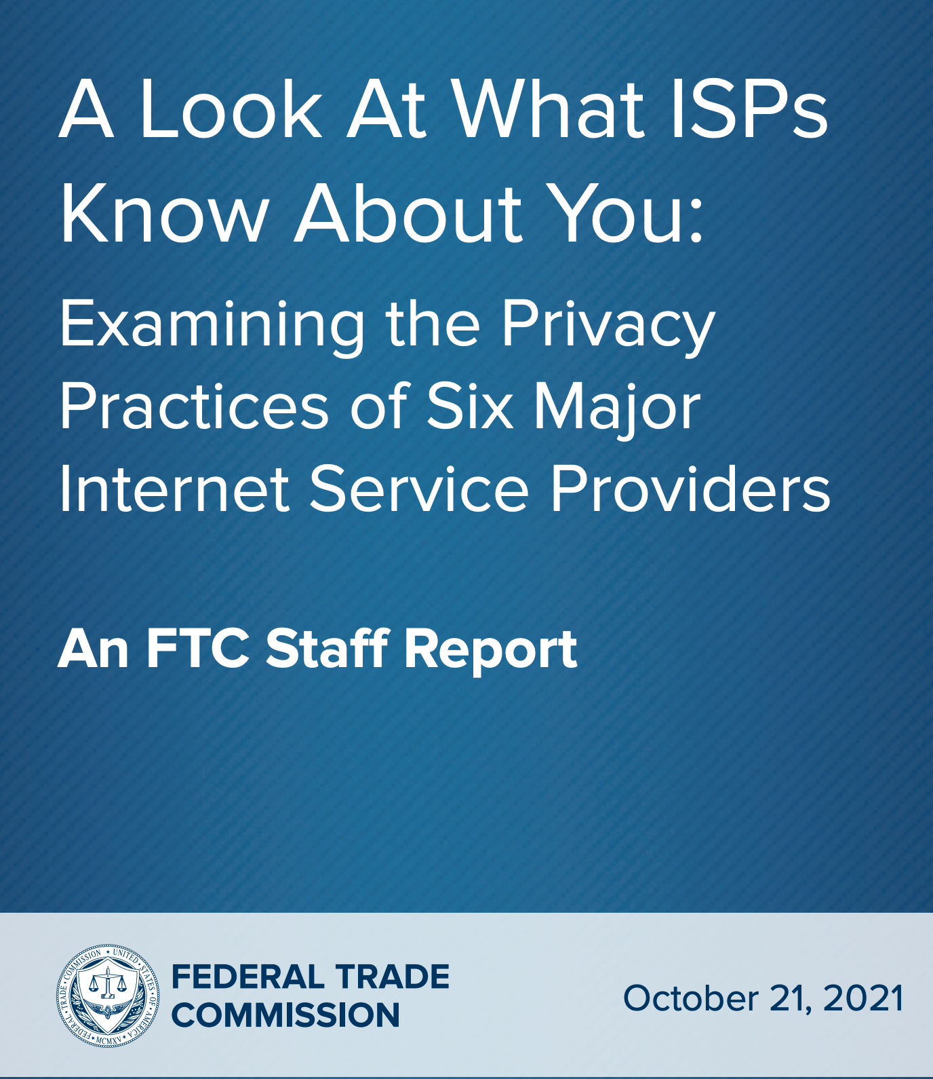
Who sees your DNS requests?
Your local DNS server
Who owns that server?
What can they figure out about you by what names you ask about?
Heath, Financial, Social, other private data...
What can they do with that information? $$$
Anyone who cares to look...
DNS on port 53 is not a confidential service and DNSSEC is not encrypted
Initially, privacy was
Not considered a requirement for DNS traffic, or
Assumed that network traffic was sufficiently private
X

Slide 6
IETF RFC 7258 "Pervasive Monitoring Is an Attack"
"Pervasive Monitoring (PM) Is a Widespread Attack on Privacy"
PM is distinguished by being indiscriminate and very large scale
Surveillance through intrusive gathering of protocol artifacts, such as
application content
protocol metadata, e.g., headers.
active or passive wiretaps
traffic analysis, (e.g., correlation, timing or measuring packet sizes)
subverting the cryptographic keys used to secure protocols

Slide 7
Options for DNS Privacy
Choose your own DNS provider
No requirement* that you use your network providers local nameserver
DNS over TLS (DoT)
DNS over HTTPS (DoH)

Slide 8
Choose Your Own DNS Provider
No need to rely on the default given by DHCP
There may be reasons to use/trust one DNS service over another
$$$, speed
Resilience to attacks; block domains associated with malicious activity
Privacy: delete or not keep logs of DNS requests
Examples
Google DNS: 8.8.8.8
Fast, Resistant to DNS attacks (Kaminsky, …), keeps request IPs for 24 hours
Cloudflare & APNIC: 1.1.1.1
Faster (according to dnsperf.com), does not log request IPs
Quad9: 9.9.9.9
Not for profit org, does not log request IPs

Slide 9
Alternative Local Nameserver Example
Destination
Web Server
Still no encryption, network eavesdropping is still a threat
Replace a suspicious or untrustworthy local nameserver
ISP Local
Nameserver
Authoritative
Nameserver
Cloudflare
1.1.1.1
TLD Authority
Root

Slide 10
Challenges
Some network operators block external DNS traffic from hosts
Security reasons: prevent lookups of malware domains
Blocking: companies/orgs may want ability to block some domains
Control: companies may want to surveille employees
Maintaining performance
Recall that local nameservers may return different answers based on geography
Important for performance, e.g., being directed to a nearby CDN
Third-party local nameservers may not return answers for nearby CDNs
DNS queries are not encrypted
Someone looking at network traffic logs can still see your queries

Slide 11
DNS over TLS (DoT)
Encrypt DNS queries and answers via Transport Layer Security (TLS)
Prevent eavesdropping and data manipulation
Uses TCP port 853
Multiple ways to authenticate the DNS server
Opportunistic, Public keys, Shared keys, …
Issues
Performance
Overhead of TCP and TLS handshakes per DNS query
Solution: maintain long-lived connections to local nameserver
No native client implementations (as of Spring 2019)
DNS
TLS
UDP
TCP
IPv4
Ethernet/Wifi

Slide 12
DNS over HTTPS (DoH)
DNS queries and answers via HTTPS
Prevent eavesdropping and data manipulation (TLS)
Ease implementation by leveraging existing HTTP infrastructure
DoH server
Accept DNS requests in POST and GET messages: application/dns-message
If HTTP/2, can PUSH additional information
Currently on by default in Firefox, uses Cloudflare
Issues
DoH client implemented directly in app
Hard to tell when queries do NOT use DoH
Not e2e encrypted
Connection to local nameserver is encrypted, but what about local nameserver to authorities?
Local nameserver still sees all queries
HTTP
DNS
TLS
TCP
IPv4
Ethernet/Wifi

Slide 13
DoH Example
Destination
Web Server
No local eavesdropping
Local nameserver still knows all queries
Local
Nameserver
Authoritative
Nameserver
Remote eavesdropping is still possible, but hard to identify queries from a single individual
TLD Authority
Root

Slide 14
The Future? Oblivious DNS
Currently a draft specification
Split architecture
DoH proxy accepts encrypted queries, forwards to DNS server
Learns client IP addresses, but not the contents of their queries
DNS server decrypts and responds to queries
Learns contents of queries, but only ever sees the IP address of the DoH proxy
The good:
Connection to local nameserver is encrypted (DoH)
Local nameserver can’t tell who is making each DNS query
The bad: still no e2e encryption requirements

Slide 15
Outline
DNS Privacy
Attacking DNS
DNS Security

Slide 16
The Importance of DNS
Without DNS…
How could you get to any websites?
You are your mailserver
When you sign up for websites, you use your email address
What if someone hijacks the DNS for your mail server?
DNS is the root of trust for the web
When a user types www.bankofamerica.com, they expect to be taken to their bank’s website
What if the DNS record is compromised?

Slide 17
Denial Of Service
Flood DNS servers with requests until they fail
October 2002: massive DDoS against the root name servers
What was the effect?
… users didn’t even notice
Root zone file is cached almost everywhere
More targeted attacks can be effective
Local DNS server → cannot access DNS
Authoritative server → cannot access domain

Slide 18
Hijacking DNS
Instead of shutting DNS down, what if we could inject arbitrary records?
E.g. www.bankofamerica.com CNAME www.my-phishing-site.com
Three types of attacks
Old school attack: record injection
Somewhat old school attack: response spoofing
New, deadly attack: The Kaminsky Attack

Slide 19
Threat Model and Attacker Goals
Where is www.bofa.com?
Honest DNS Servers
Local
Nameserver
Active attacker, may send DNS packets
Remote attacker, may not eavesdrop
Attacker may control their own domains and DNS servers
I want to add a record to that local nameserver that directs www.bofa.com → 6.6.6.6
102.32.0.1
6.6.6.6

Slide 20
Review: Glue Records
DNS responses may contain more than a single answer
Example: resolving cyclic dependency
TxID: 5678
Q: 1 | A: 0
Auth: 1 | Addl: 1
Q: Where is .com?
Auth: NS a.gtld-server.com
Addl: A a.gtld-server.com 12.56.10.1
TxID: 5678
Q: 1 | A: 0
Auth: 0 | Addl: 0
Q: Where is .com?
asgard.ccs.neu.edu
Root
Known as glue records
Additional responses can contain any type of record (i.e., A, NS, etc.)

Slide 21
Record Injection
Honest DNS Servers
Local
Nameserver
Where is www.bofa.com?
TxID: 12346
Q: 1 | A: 1
Auth: 0 | Addl: 1
Q: Where is www.attacker.net?
A www.attacker.net 128.1.2.0
Addl: A www.bofa.com 6.6.6.6
Where is www.attacker.net?
102.32.0.1
6.6.6.6
ns.attacker.net

Slide 22
Bailiwick Checking
Record injection attacks no longer work in practice
All modern DNS servers implement bailiwick checking
Only records related to the requested domain are accepted in responses
In other words, DNS servers are less trusting of additional information

Slide 23
Review: DNS Packet Format
ID number used to match requests and responses
0
16
32
TxID | Flags
Question Count | Answer Count
Authority Count | Additional Record Count
Question and answer data (Resource Records, variable length)
DNS is a UDP-based protocol on port 53
No TCP means no connections
TxIDs are needed to correlate requests and responses
Serves as authentication for responses

Slide 24
Response Spoofing
Honest DNS Servers
Local
Nameserver
TxID: 12347
Q: 1 | A: 0
Auth: 0 | Addl: 0
Q: Where is www.bofa.com?
TxID: ????
Q: 1 | A: 1
Auth: 0 | Addl: 1
Q: Where is www.bofa.com
A www.bofa.com 6.6.6.6
Where is www.bofa.com?
102.32.0.1
6.6.6.6

Slide 25
Implementing Response Spoofing
What info does the attacker need to spoof a DNS response?
IP address of the target nameserver and true authoritative nameserver
Easy, both pieces of info are readily available
Source port used by the authoritative nameserver
Easy, it must be 53
The question in the query
Easy, the attacker can choose the targeted domain name
Response port used by the target when they made the request
TxID in the query
Old DNS servers used one port for all queries and incremented TxID monotonically
Attacker can query the target DNS server for a domain they control and observe the query at their own DNS server
The query reveals the port used by the target, as well as the approximate TxID

Slide 26
Inspecting the Target
Honest DNS Servers
Local
Nameserver
TxID: 12347
Q: 1 | A: 0
Auth: 0 | Addl: 0
Q: Where is www.attacker.net?
Where is www.attacker.net?
102.32.0.1
6.6.6.6
ns.attacker.net

Slide 27
Conditions for Successful Response Spoofing
Attacker must infer the response port of the target nameserver and TxID
Attacker’s response must outrace the legitimate response
The attack must be executed after the target nameserver is queried for a domain that is not in the cache
If the target domain name is already cached, no queries will be sent
The attacker can send the initial query to the nameserver, but if the attack fails the legitimate response will be cached until the TTL expires
If the attack is successful, the record for a single domain is poisoned

Slide 28
Kaminsky Attack
Variation of the response spoofing attack that is much more powerful
Discovered by notable security researcher Dan Kaminsky in 2008
Poisons glue records rather than A records
Attacker repeatedly makes queries for non-existent subdomains of the target domain
Since these subdomains do not exist, they are guaranteed to not be in the target nameservers cache
Attacker then attempts to spoof a response with a poison glue record
The attacker can attempt the attack an infinite number of times until success
On success, entire zone is poisoned, rather than a single domain name

Slide 29
Kaminsky Attack
Honest DNS Servers
Local
Nameserver
Where is www.bofa.com?
Where is aaaa.bofa.com?
Where is aaab.bofa.com?
TxID: ????
Q: 1 | A: 1
Auth: 1 | Addl: 1
Q: Where is aaaa.bofa.com
A: aaaa.bofa.com = 127.0.0.1
Auth: NS = ns1.bofa.com
Addl: ns1.bofa.com = 6.6.6.8
TxID: ????
Q: 1 | A: 1
Auth: 1 | Addl: 1
Q: Where is aaab.bofa.com
A aaab.bofa.com 127.0.0.1
Auth: NS ns1.bofa.com
Addl: A ns1.bofa.com 6.6.6.8
ns.attacker.net
6.6.6.8
102.32.0.1
6.6.6.6

Slide 30
Mitigating the Kaminsky Attack
The Kaminsky attack relies on fundamental properties of the DNS protocol
Specifically, the ability to respond with NS records and glue to any query
The functionality is essential for DNS, it cannot be disabled
How do you mitigate the Kaminsky attack?
Make it harder to spoof DNS responses
All modern DNS servers randomize the TxID and query port for every request
2¹⁶ TxIDs * 2¹⁶ query ports = 2³² messages needed to spoof successfully
Use heuristics to detect flood of spoofed responses
Use cryptography to ensure the integrity of DNS records (DNSSEC)

Slide 31
Additional DNS Hijacks
Infect the target user’s OS or browser with a virus/trojan
e.g. Many trojans change entries in /etc/hosts
*.bankofamerica.com → evilbank.com
Man-in-the-middle
DNS is not encrypted or strongly authenticated

Slide 32
Outline
DNS Privacy
Attacking DNS
DNS Security

Slide 33
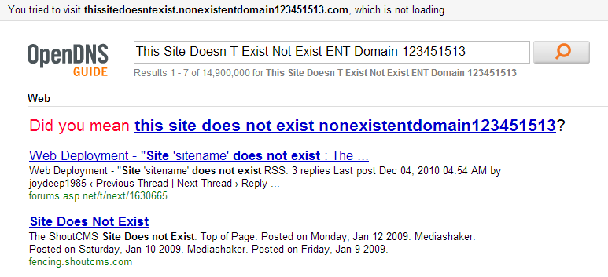
Site Finder
September 2003: Verisign created DNS wildcards for *.com and *.net
Essentially, catch-all records for unknown domains
Pointed to a search website run by Verisign
Search website was full of advertisements
Extremely controversial move
Is this DNS hijacking?
Definitely abuse of trust by Verisign
Site Finder was quickly shut down, lawsuits ensued

Slide 34
Authentication for DNS
Domain Name System Security Extensions (DNSSEC)
Integrates a public key infrastructure (PKI) into DNS
Provides end-to-end authentication and integrity, but not confidentiality
Prevents DNS hijacking!
But, complex to deploy, some performance overhead, power given to DNS root
Deployment
On the roots since July 2010
Verisign enabled it on .com and .net in January 2011
Comcast was the first major ISP to support it (January 2012)

Slide 35
DNSSEC High-level Approach
Authoritative DNS Servers
DNS Clients and Local Nameservers
Hierarchical PKI rooted in the DNS roots
Root DNS servers sign keys for each TLD
Each TLD signs keys for second-level domain owners
Domain owners sign their resource records with their keys
Clients ask local nameservers to verify record integrity
Local name servers verify signature integrity during recursive resolution
All of these pieces need to work for DNSSEC to succeed!

Slide 36
DNSSEC Details
Cryptographically sign critical resource records
Resolver can verify the cryptographic signature
Six new DNS record types
RRSIG
Digital signature of a specific resource record
Signed by the private key of the zone
DNSKEY
Public key for a zone
Signed by the private key of the parent zone
Signatures from the root servers are trusted by default
DS
Delegated signer, contains hash of DNSKEY record
CDNSKEY and CDS
Allows child zones to update DS records in parent zones
Prevents hijacking and spoofing
Creates a hierarchy of trust within each zone
NSEC*
Signed denial of record existence

Slide 37
Simplified DNSSEC Example
www.google.com
Is this A record authentic?
Where is www.google.com?
A www.google.com 128.1.0.4
RRSIG {Hash(A)}_{Sgoogle}
DNSKEY P_{google}
Q: Where is www.google.com?
Is Google’s DNSKEY authentic?
Local Nameserver
ns1.google.com
NS a.gtld-server.com
A a.gtld-server.com 143.7.0.1
DS Hash(DNSKEY P_{com})
RRSIG {Hash(DNSKEY P_{com})} _{SRoot}
DNSKEY P_{Root}
NS ns1.google.com
A ns1.google.com 8.8.0.2
DS Hash(DNSKEY P_{google})
RRSIG {Hash(DNSKEY P_{google})} _{Scom}
DNSKEY P_{com}
Root’s DNSKEY is well-known and trusted
a.gtld-server.com
.google.com Authority uses DNSSEC
.com Authority uses DNSSEC
Is .com’s DNSKEY authentic?
Root

Slide 38
DNSSEC Example, Again
Record | Validated Using… | Interpretation
A www.google.com 128.1.0.4 | RRSIG and DNSKEY from .google.com. | This is Google’s legitimate A record because the corresponding RRSIG was signed by S_{google}
RRSIG {Hash(A www.google.com 128.1.0.4)}_{Sgoogle}
DNSKEY P_{google} | DS, RRSIG, and DNSKEY from .com. | This is Google’s legitimate public key because the corresponding RRSIG was signed by S_{com}
DS Hash(DNSKEY P_{google})
RRSIG {Hash(DNSKEY P_{google})}_{Scom}
DNSKEY P_{com} | DS, RRSIG, and DNSKEY from root | This is .com’s legitimate public key because the corresponding RRSIG was signed by S_{root}
DS Hash(DNSKEY P_{com})
RRSIG {Hash(DNSKEY P_{com})}_{Sroot}
DNSKEY P_{root} | Assumed to be trusted | The P_{root} keys are built-in to most DNS software, they are trusted by default
Google NS
.com NS
root NS

Slide 39
Exercise: $ dig 4700.network +dnssec
$ dig @1.1.1.1 4700.network +dnssec
;; global options: +cmd
;; Got answer:
;; ->>HEADER<<- opcode: QUERY, status: NOERROR, id: 51986
;; flags: qr rd ra ad; QUERY: 1, ANSWER: 2, AUTHORITY: 0, ADDITIONAL: 1
;; OPT PSEUDOSECTION:
; EDNS: version: 0, flags: do; udp: 1232
;; QUESTION SECTION:
;4700.network. IN A
;; ANSWER SECTION:
4700.network. 1799 IN A 129.10.123.70
4700.network. 1799 IN RRSIG A 13 2 1799 …
$ dig @1.1.1.1 4700.network DNSKEY +dnssec
;; global options: +cmd
;; Got answer:
;; ->>HEADER<<- opcode: QUERY, status: NOERROR, id: 5515
;; flags: qr rd ra ad; QUERY: 1, ANSWER: 3, AUTHORITY: 0, ADDITIONAL: 1
;; OPT PSEUDOSECTION:
; EDNS: version: 0, flags: do; udp: 1232
;; QUESTION SECTION:
;4700.network. IN DNSKEY
;; ANSWER SECTION:
4700.network. 759 IN DNSKEY 256 3 13 t8vGvWUb+…
4700.network. 759 IN DNSKEY 257 3 13 d8qfHFySTwB…
4700.network. 759 IN RRSIG DNSKEY 13 2 3601 …
Binary Authenticated Data (AD) flag from the resolver

Slide 40
Attack Example 1: Spoofing
www.google.com
Where is www.google.com?
DS for google.com means there should be RRSIG and DNSKEY records
A www.google.com 128.1.0.4
RRSIG {Hash(A)}_{Sgoogle}
DNSKEY P_{google}
asgard.ccs.neu.edu
ns1.google.com
NS ns1.google.com
A ns1.google.com 8.8.0.2
DS Hash(DNSKEY P_{google})
RRSIG {Hash(DNSKEY P_{google})} _{Scom}
DNSKEY P_{com}
A www.google.com 123.45.67.89
a.gtld-server.com
Root

Slide 41
Attack Example 2: Spoofing
www.google.com
Where is www.google.com?
Correct DNSKEY, but P_{google} and S_{attacker} don’t correspond
A www.google.com 128.1.0.4
RRSIG {Hash(A)}_{Sgoogle}
DNSKEY P_{google}
asgard.ccs.neu.edu
ns1.google.com
NS ns1.google.com
A ns1.google.com 8.8.0.2
DS Hash(DNSKEY P_{google})
RRSIG {Hash(DNSKEY P_{google})} _{Scom}
DNSKEY P_{com}
A www.google.com 123.45.67.89
RRSIG {Hash(A Record)}_{Sattacker}
DNSKEY P_{Google}
a.gtld-server.com
Root

Slide 42
Attack Example 3: Spoofing
www.google.com
Where is www.google.com?
RRSIG validates, but P_{attacker} is not Google’s DNSKEY
A www.google.com 128.1.0.4
RRSIG {Hash(A)}_{Sgoogle}
DNSKEY P_{google}
asgard.ccs.neu.edu
ns1.google.com
NS ns1.google.com
A ns1.google.com 8.8.0.2
DS Hash(DNSKEY P_{google})
RRSIG {Hash(DNSKEY P_{google})} _{Scom}
DNSKEY P_{com}
A www.google.com 123.45.67.89
RRSIG {Hash(A Record)}_{Sattacker}
DNSKEY P_{attacker}
a.gtld-server.com
Root

Slide 43
Attack Example 4: Denial
www.google.com
Where is www.google.com?
DS for google.com means error response should be NSEC (signed)
A www.google.com 128.1.0.4
RRSIG {Hash(A)}_{Sgoogle}
DNSKEY P_{google}
asgard.ccs.neu.edu
ns1.google.com
NS ns1.google.com
A ns1.google.com 8.8.0.2
DS Hash(DNSKEY P_{google})
RRSIG {Hash(DNSKEY P_{google})} _{Scom}
DNSKEY P_{com}
NXDOMAIN for www.google.com
a.gtld-server.com
Root

Slide 44
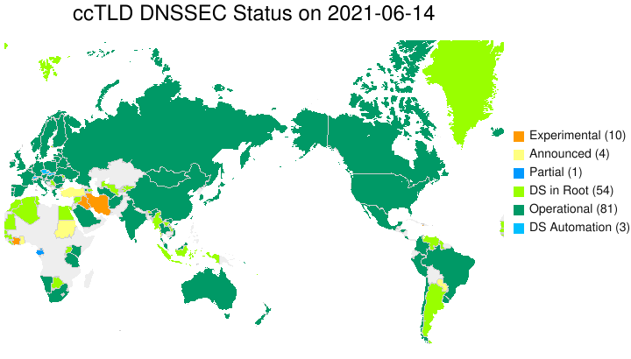
DNSSEC adoption by Country Code TLDs
Are top level domains adopting DNSSEC?
https://www.internetsociety.org/deploy360/dnssec/maps/

Slide 45
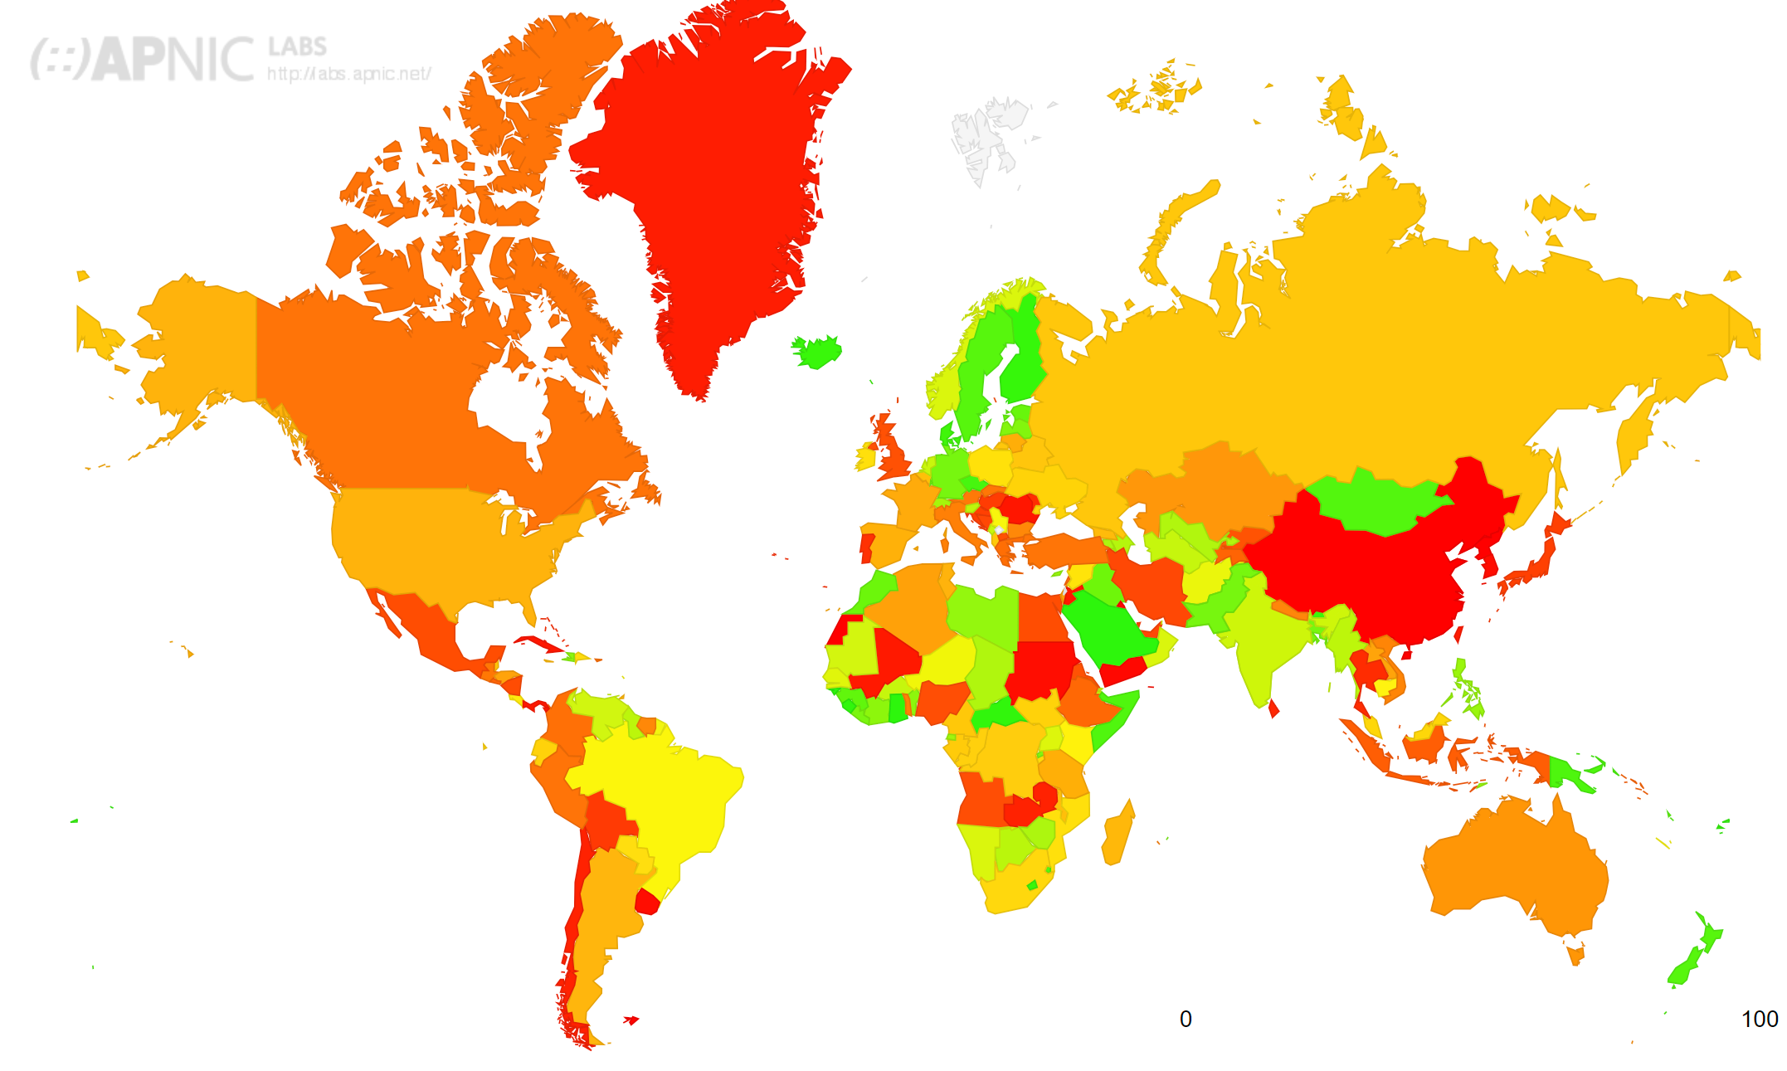
DNSSEC Validation Rates
Are local DNS resolvers validating DNSSEC records?
https://stats.labs.apnic.net/dnssec

Slide 46
How Well is DNSSEC managed?
Looked at 147M domains, 60K+ resolvers over 21 months
TLDs, ccTLDs broadly deploy
But only 1-2% of second-level domains use it
Pervasive record mismanagement
Nearly 33% of DNSSEC-enabled domains can’t be validated
Resolvers not validating properly
80+% of resolvers ask for DNSSEC records
Only 12% bother to check the result!
Chung et al. “A Longitudinal, End-to-End View of the DNSSEC Ecosystem”,
Usenix Security 2017. https://cbw.sh/static/pdf/chung-usenix17.pdf

Slide 47
DNSSEC Takeaways
DNS records are security critical information
Hijacking DNS can result in many harms (e.g., surveillance, phishing, censorship)
DNSSEC is critical for authenticating DNS records
Creates a hierarchical PKI for authenticating DNS resource records
DNSSEC deployment is a mixed bag
Adopted by roots and TLDs, not well adopted by second-level domains
DNSSEC validation by local nameservers remains a problem
Some major ISPs (e.g., Comcast) have adopted
Third-party resolvers (e.g., Google and Cloudflare) have adopted
If you own a domain and your registrar supports DNSSEC, turn it on!

Slide 48
Further Reading
Chung et al. “A Longitudinal, End-to-End View of the DNSSEC Ecosystem”, Usenix Security 2017. https://cbw.sh/static/pdf/chung-usenix17.pdf
Chung et al. “Understanding the Role of Registrars in DNSSEC Deployment”, Internet Measurement Conference, 2017. https://cbw.sh/static/pdf/chung-imc17.pdf
Muller et al. “Roll, Roll, Roll your Root: A Comprehensive Analysis of the First Ever DNSSEC Root KSK Rollover”, Internet Measurement Conference, 2019. https://taejoong.github.io/pubs/publications/muller-2019-ksk.pdf
Muller et al. “The Reality of Algorithm Agility: Studying the DNSSEC Algorithm Life-Cycle”, Internet Measurement Confernce, 2020. https://taejoong.github.io/pubs/publications/muller-2020-algorithm.pdf

