Slide 1
CS 4700 / CS 5700
Network Fundamentals
Project 5 Hints
(Getting a job at Akamai)

Slide 2
DNS server issue
Can you login to the server in dns-hosts.txt (173.255.237.185)?
Can you login to the host in http-repls.txt (45.33.99.146)?

Slide 3
Review: Optimizing Performance
Key goal
Send clients to server with best end-to-end performance
Performance depends on
  Server load
  Content at that server
  Network conditions
Optimizing for server load
  Load balancing, monitoring at servers
  Generally solved

Slide 4
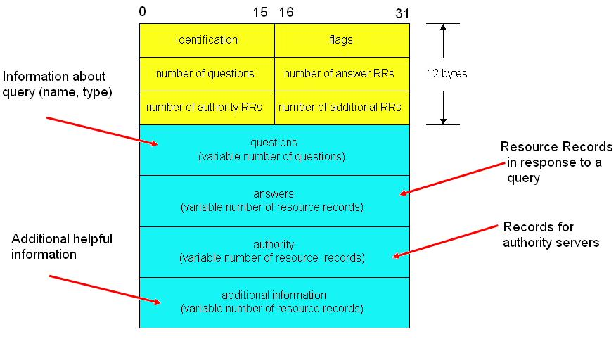
DNS Redirection

Slide 5
How to fill in DNS response
Geolocation
  GeoIP database provides IP->location
  Which IP address should you lookup?
  How should you use the location?
Active measurement
  Ping latencies
  What should you probe?
  iPlane dataset contains useful information
Passive measurement
  How can you measure RTT without any active probes?

Slide 6
Caching Web server
Space on each account is limited
  20 MB for a corpus that much larger
  Distribution of requests to content:
    /course/cs5700sp17/popular_raw.html
General approach
  Examine GET parameters
  Check database for content
    If present, serve from cache
    If not, fetch from origin and (possibly) cache

Slide 7
Running replicated services
Step 1: Debug on a single machine interactively
Step 2: Develop scripts to automate running
Step 3: Test on one server and make sure everything works properly
Step 4: Test on two servers in a fully automated deployment
Step 5: Deploy on all servers

Slide 8
CS 4700 / CS 5700
Network Fundamentals
Data Center Networks
(What’s in all those clouds?)
Revised 4/4/2024

Slide 9
“The Network is the Computer”
Network computing has been around forever
  Grid computing
  High-performance computing
  Clusters (Beowulf)
Highly specialized
  Nuclear simulation
  Stock trading
  Weather prediction
Datacenters/the cloud are a HOT area
  Why?

Slide 10
The Internet Made Me Do It
Everyone wants to operate at Internet scale
  Millions of users
    Can your website/app/SaaS/… survive a flash mob?
  Big Data: Zetabytes of data to analyze
    Webserver logs
    Advertisement clicks
    Social networks, blogs, Twitter, video…
Not everyone has the expertise to build a cluster
  The Internet is the symptom and the cure
  Let someone else do it for you!

Slide 11
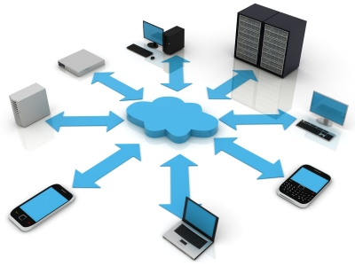
The Nebulous Cloud
What is “the cloud”?
Everything as a service
  Hardware
  Storage
  Platform
  Software
Anyone can rent computing resources
  Cheaply
  At large scale
  On demand

Slide 12
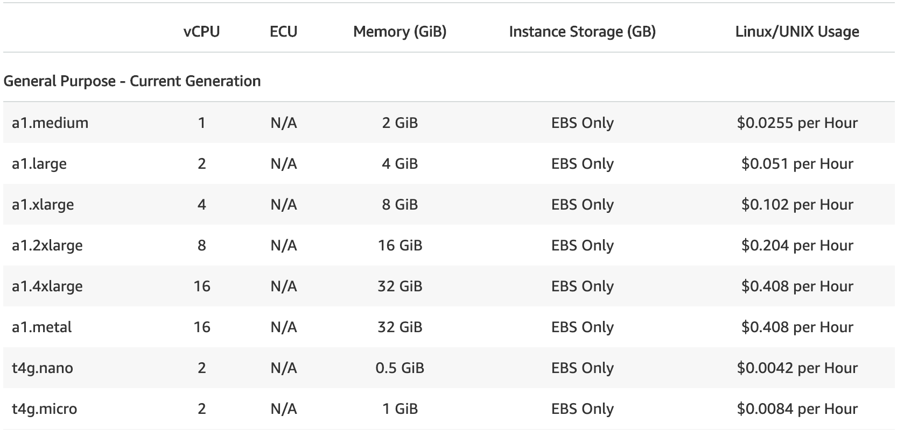
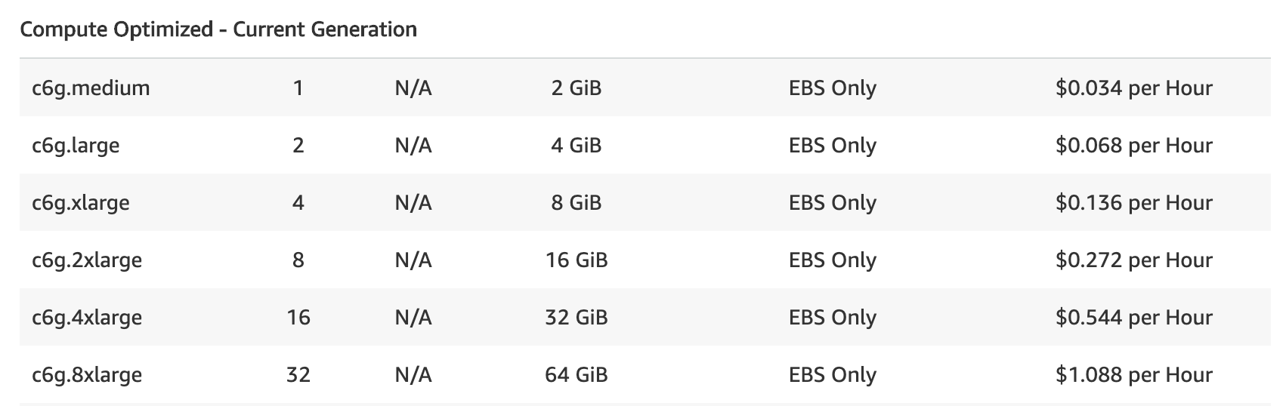
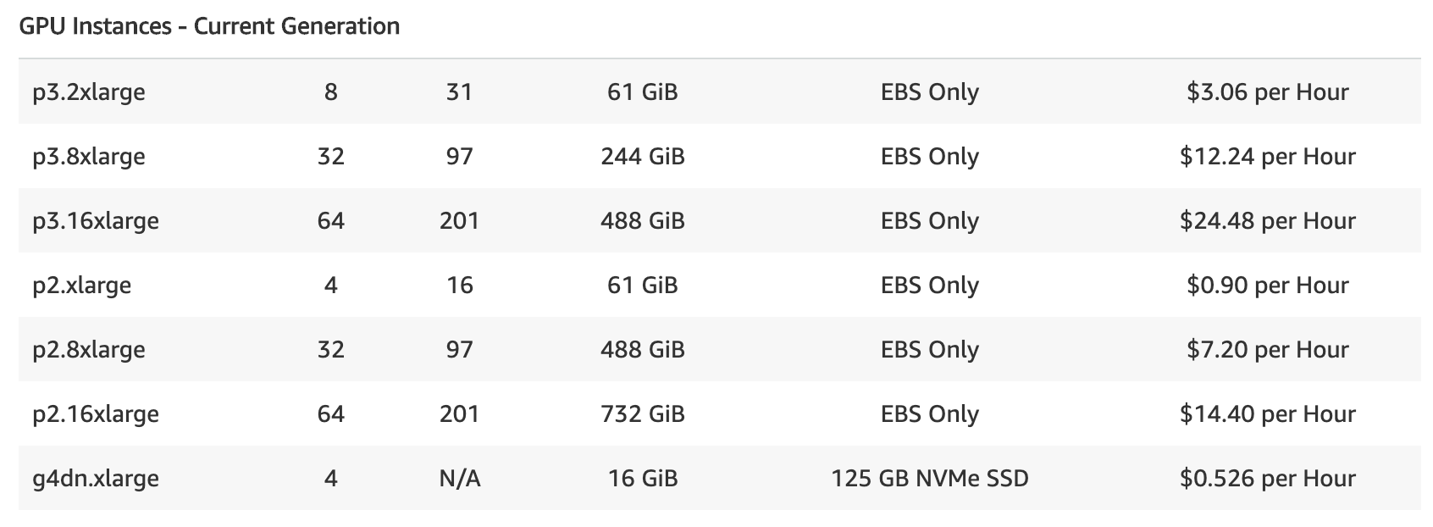
Example: Amazon EC2
Amazon’s Elastic Compute Cloud
  Rent any number of virtual machines
  For as long as you want
Hardware and storage as a service

Slide 13
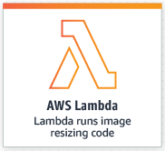
Example: Amazon Lambda
Platform for deploying “functions”
  “function as a service” (FaaS)
From the developer's perspective:
  Write a function in JavaScript
  Use Amazon’s API to accept input and produce output
  Deploy snippet of code to Amazon’s servers
  Amazon takes care of running the function whenever an event is triggered
  Amazon handles scaling up and replicating the function globally
From Amazon’s perspective:
  Manage a datacenter full of machines and storage
  All machines execute the Lambda runtime
  Deploy JavaScript functions from customers
  Load balance incoming requests
  Scale up customer functions as needed
    Execute multiple instances of the function

Slide 14


Slide 15
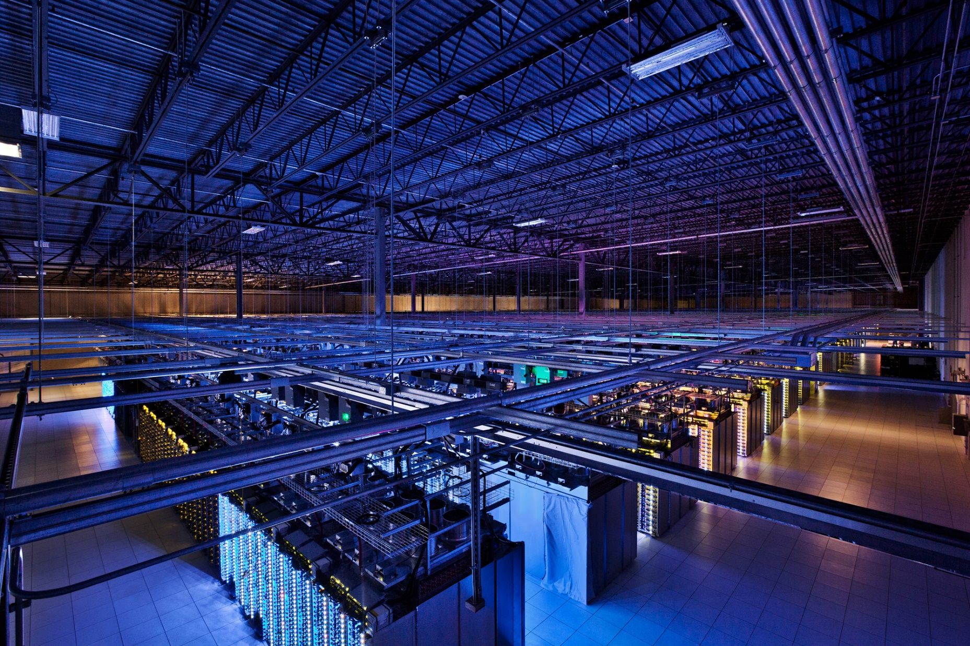

Slide 16
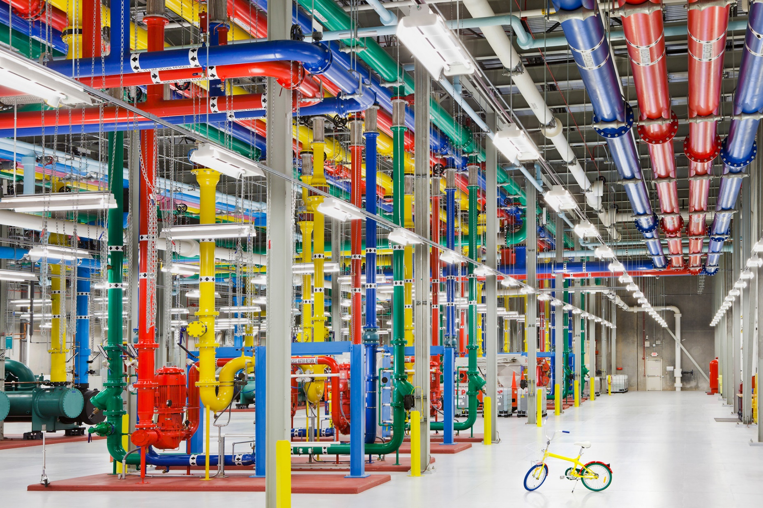

Slide 17



Typical Datacenter Topology: the Fat Tree
The Internet
Core Routers
Link Redundancy
Aggregation Routers
100 Gbps Ethernet
Top of Rack (ToR) Switches
10 Gbps Ethernet
20-40 Servers Per Rack

Slide 18
Advantages of Current Designs
Cheap, off the shelf, commodity parts
  No need for custom servers or networking kit
  (Sort of) easy to scale horizontally
    Just add more racks of servers and expand the tree
Runs standard software
  No need for “clusters” or “grid” OSs
  Stock networking protocols
Ideal for VMs
  Highly redundant
  Homogeneous

Slide 19
Lots of Problems
Data Centers mix customers and applications
  Heterogeneous, unpredictable traffic patterns
  Competition over resources
  How to achieve high-reliability?
  Privacy
Heat and Power
  30 billion watts per year, worldwide
  May cost more than the machines
  Not environmentally friendly
All actively being researched

Slide 20
Outline
Network Topology and Routing
  Fat Tree
  Clos
Transport
  ECN
  DCTCP

Slide 21
Network Problems
Data Centers are data intensive
Most hardware can handle this
  CPUs scale with Moore’s Law
  RAM is fast and cheap
  RAID and SSDs are pretty fast
Current networks cannot handle it
  Slow, not keeping pace over time (does not follow Moore’s Law)
  Expensive (ports/blade, blades/router, fabric capacity, …)
  Wiring is a nightmare
  Hard to manage
  Non-optimal protocols

Slide 22
Problem: Routing
In a typical datacenter…
  Multiple customers
  Multiple applications
VM allocation on demand
How do we place them?
  Performance
  Scalability
  Load-balancing
  Fragmentation
VLAN Routing
is a problem
10.0.0.*
10.0.0.*
13.0.0.*

Slide 23
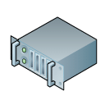


Virtual Layer-2 (VL2)
Idea: insert a layer 2.5 into the network stack
  Translate virtual IPs to actual IPs
  Mapping maintained using directory servers
128.0.0.1
129.0.0.1
164.0.0.1
10.0.0.1
10.0.0.2

Slide 24
VL2 at a Glance
Benefits
  No more VLANs
  Easy VM migration
  Multi-path load balancing
    OSPF in the core (as opposed to spanning tree)
    Equal cost multipath (ECMP)
Semi-easy to deploy
  No modifications to applications, protocols
  Leverage existing switch/router features
  No additional wires
Issues
  Must modify host OSs
  Need directory servers (and they need to scale)

Slide 25
Problem: Oversubscription in Fat Tree Topologies
#Racksx40x10 Gbps → 1x100 Gbps
1:80-240
40x10Gbps → 1x100 Gbps
1:4
Bandwidth gets scarce as you move up the tree
Locality is key to performance
All-to-all communication is a very bad idea
40x10 Gbps Ports
1:1
40 Machines
10 Gbps Each

Slide 26
Consequences of Oversubscription
Oversubscription cripples your datacenter
  Limits application scalability
  Bounds the size of your network
Problem is about to get worse
  100 GigE servers are becoming affordable (100GigE NIC is <$1000)
  128 port 100 GigE routers are not ($66k for 64 ports)
Oversubscription is a core router issue
  Bottlenecking racks of 10GigE or 100 GigE into 100 GigE uplinks
What if we get rid of the core routers?
  Only use cheap switches
  Try to maintain close to 1:1 oversubscription ratio

Slide 27


Clos Topology
Generic term from the 1950’s for building networks with redundant paths
Core Routers
Spine Switches
Leaf
Switches

Slide 28
Clos Topologies at a Glance
The good
  Less oversubscription due to multiple paths in the leaf-spine mesh
  More link redundancy in case of line failures or spine switch failures
  Customizable based on the ratio of leaf to spine routers
The bad
  Need custom layer-2 routing protocols
    Spanning tree no longer works
  Does not achieve full bisection bandwidth
  Cost due to more switches
The ugly
  OMG, the wires

Slide 29
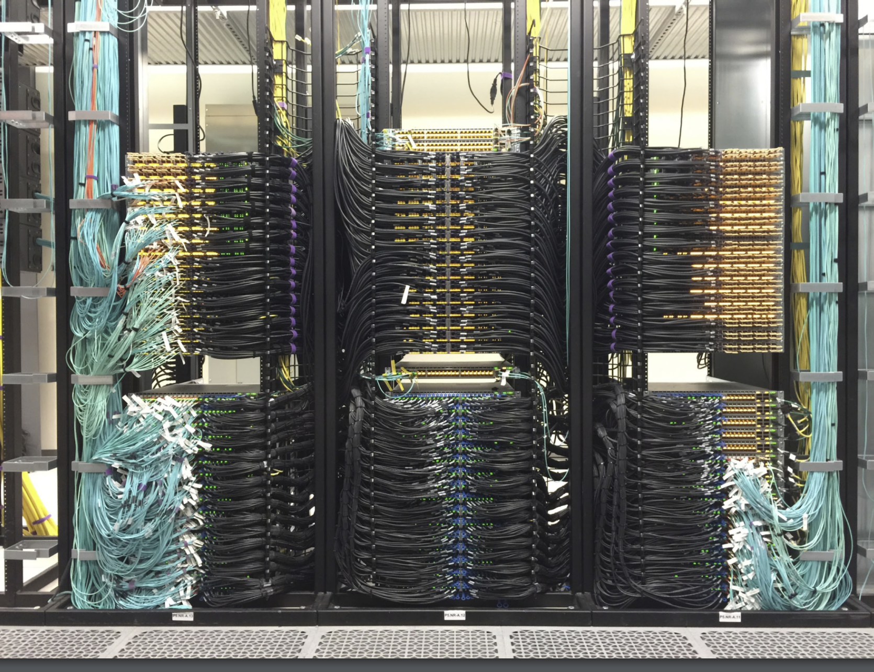
https://pc.nanog.org/static/published/meetings/NANOG76/1996/20190610_Gashinsky_Demystifying_Datacenter_Clos_v1.pdf

Slide 30

K-ary Fat Tree Topology
To build a K-ary fat tree
K-port switches
K pods, each with K switches
K³/4 servers
(K/2)² core switches
In this example K=4
4-port switches
4 pods, each with 4 switches
K³/4 = 16 servers
(K/2)² = 4 core switches
Pod

Slide 31
K-ary Fat Trees at a Glance
The good
  Full bisection bandwidth
  Lots of redundancy for failover
The bad
  Need custom layer-2 routing protocols
    Spanning tree no longer works
  Cost → 3K²/2 switches
    48 port switches = 3456
The ugly
  OMG THE WIRES!!!! → (K³+2K²)/4
    48 port switches = 28800

Slide 32
Outline
Network Topology and Routing
  Fat Tree
  Clos
Transport
  ECN
  DCTCP

Slide 33
Transport on the Internet vs. the Data Center
TCP is optimized for the WAN
  Fairness
    Slow-start
    AIMD convergence
  Defense against network failures
    Three-way handshake
    Reordering
  Zero knowledge congestion control
    Self-induces congestion
    Loss always equals congestion
  Delay tolerance
    Ethernet, fiber, Wi-Fi, cellular, satellite, etc.
Data centers are not the Internet!
  Networks are very reliable
    Self-induced congestion is a bigger problem
  Latencies are very small (250µs)
    Agility is key!
    Delay-based congestion control approaches fail
  Many flows are small
    TCP is biased against small flows
    Low delay + many small flows = challenging network contention environment

Slide 34
Rethinking Data Center Transport
Key insight: possible to make unilateral changes in data center networks
  Homogeneous hardware/software
  Single administrative domain
Approach 1: Explicit Congestion Notification
  Feature that is already part of TCP/IP, but does not work on the Internet
Approach 2: Modify TCP
  Data Center TCP (DCTCP)

Slide 35
Explicit Congestion Notification (ECN)
Use TCP/IP headers to explicitly signal congestion to senders
Implementation sketch
  Routers that are about to experience congestion set the ECN bit in IP headers
  Receiver copies the ECN bit into the ECN flag of the TCP ACK packet
  Sender receives the ACK with the ECN flag set
  Sender treats the ECN-ACK just like a dropped packet, triggers congestion backoff
Advantages
  Already part of the TCP/IP specification
  Modern switches/routers support ECN but it’s off by default. Just turn it on!
  No need for TCP congestion control to rely on imperfect signals like packet loss or delay
  No need to actually drop packets anymore unless load is severe!

Slide 36
IP Header, Revisited
Last time you saw this, we ignored the DSCP/ECN field
Turns out, it’s actually useful!
0
4
8
12
16
19
24
31
Version
HLen
DSCP/ECN
Datagram Length
Identifier
Flags
Offset
TTL
Protocol
Checksum
Source IP Address
Destination IP Address
Options (if any, usually not)

Slide 37
TCP Header, Revisited
Common TCP flags: SYN, ACK, RST, FIN
ECN is also a flag!
0
4
16
31
Source Port
Destination Port
Sequence Number
Acknowledgement Number
HLen
Flags
Advertised Window
Checksum
Urgent Pointer
Options

Slide 38

Explicit Congestion Notification
Use TCP/IP headers to send ECN signals
  Router sets ECN bit in IP header if there is congestion
  Host TCP treats ECN marked packets the same as packet drops (i.e., congestion signal)
    But no packets are dropped :)
Sender receives feedback
No Congestion
Congestion
ECN flag set in TCP ACK

Slide 39
Wait A Minute…
If ECN is so great, why don’t we have it on the Internet?
All modern OS and switches/routers support ECN, but it’s not always enabled
  86% of the top 100K websites appear to support ECN
  However, not all client OSes signal support in their TCP SYN
End host support is not the same as network support
  Routers with ECN disabled still drop packets
Some networks “bleach” the ECN bits
  Erase the bits in TCP/IP headers
  Some even drop packets with the ECN bits set
https://arxiv.org/pdf/2208.14523.pdf

Slide 40
Beyond ECN
Limitation with ECN: feedback is treated as binary
  If ECN flag is set, treat it the same as packet loss
  Multiplicative decrease in TCP cwnd, adjust thresholds downward
  No concept of proportionality
Idea: turn single-bit ECN scheme into multi-bit
  Use existing ECN functionality in routers to mark packets
  Scale window in proportion to congestion

Slide 41
Data Center TCP (DCTCP)
Goals
  Alter TCP implementation in the OS to achieve low latency, no queue buildup
  Do not modify applications, switches, or routers
  Work with cheap, shallow buffered switches
DCTCP scheme
  Switches/routers mark ECN bits in IP headers as usual (no change)
  Receiver echoes the ECN bits as usual (no change)
  Sender estimates congestion (0 ≤ α ≤ 1) each RTT based on fraction of marked ACKs
  cwnd = cwnd * (1 – α/2)
Original DCTCP paper: https://dl.acm.org/doi/pdf/10.1145/1851182.1851192
Performance and fairness evaluation: https://dl.acm.org/doi/pdf/10.1145/2007116.2007125

Slide 42
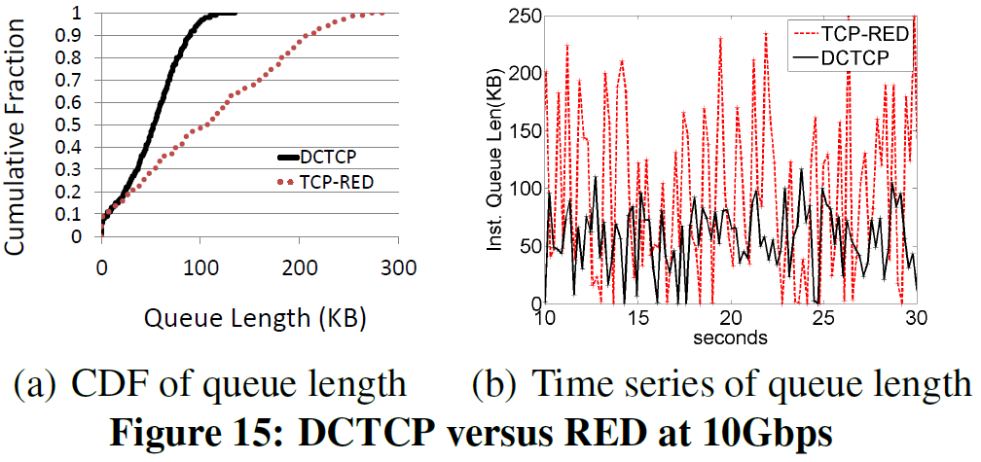
DCTCP vs. TCP+RED

Slide 43
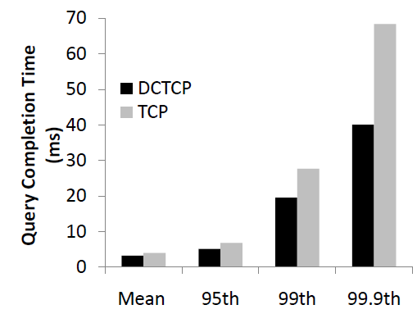
Query Completion Times

Slide 44
DCTCP in Practice
Benefits of DCTCP
  Better performance than TCP
  Alleviates losses due to buffer pressure
  Simple, straightforward implementation
DCTCP is used in practice in many data centers
  RFC 8257
  Implemented in the Linux kernel
QUIC uses the DCTCP congestion controller on ECN-enabled connections

Slide 45
Swift: Google’s CC for the Datacenter
Context
  Low latency workloads
  OS bypass by networking stacks
  Increasing line rates
Challenges
  Diverse workload
  Large-scale incast
  Host/fabric congestion
Opportunity
  Hardware timestamps on modern NICs offer high-accuracy RTT estimation
  Build delay-based CC on top of these accurate timestamps

Slide 46
Swift: Google’s CC for the Datacenter
Solution
  Uses AIMD like standard TCP
  Use a target delay in TCP, and aggressively pace to ensure flows are kept at the target
  Breaks down delay into host vs fabric, adjusts accordingly
Results
  Nearly 100% line rate for 100Gbps links
  Nearly zero loss

Slide 47
Conclusions
Data centers are a super hot topic in the research community
  Heat, power, ecological friendliness
  Topology, routing, software-defined networking
  Congestion control
  VM migration, management, debugging
  Applications: Hive, Spark, Kafka, NoSQL, MapReduce, Hadoop, Cassandra, Dynamo
Tough to bootstrap research
  Most papers from a large company (Microsoft, FB, Google, Cloudflare, etc.)
  Who else has the hardware to do the research?
  Who has real traces of data center traffic to analyze and use for simulation?

