Slide 1
CS 4700 / 5700
Network Fundamentals
Congestion Control
(You thought we were done with TCP?)
Revised 2/22/24

Slide 2
Transport Layer
Function:
  Demultiplexing of data streams
Optional functions:
  Creating long lived “connections”
  Reliable, in-order packet delivery
  Error detection
  Flow and congestion control
Key challenges:
  Detecting and responding to congestion
  Balancing fairness against high utilization
Application
Presentation
Session
Transport
Network
Data Link
Physical

Slide 3
Outline
Congestion Basics
TCP Tahoe
TCP Reno
TCP Cubic
BBR

Slide 4
What is Congestion?
Load on the network is higher than capacity
  Capacity is not uniform across networks
    Modem vs. Cellular vs. Cable vs. Fiber Optics
  There are multiple flows competing for bandwidth
    Residential cable modem vs. corporate datacenter
  Load is not uniform over time
    9pm Sunday night = everyone streaming Netflix

Slide 5
Why is Congestion Bad?
Results in packet loss
  Routers have finite buffers, packets must be dropped
Practical consequences
  Router queues build up, delay increases
  Wasted bandwidth from retransmissions
  Low network goodput

Slide 6
The Danger of Increasing Load
Congestion Collapse
Knee – point after which
  Throughput increases very slowly
  Delay increases quickly
In an M/M/1 queue
  Delay = 1/(1 – utilization)
Cliff – point after which
  Throughput → 0
  Delay → ∞
Knee
Cliff
Goodput
Ideal point
Load
Delay
Load

Slide 7
Cong. Control vs. Cong. Avoidance
Congestion Avoidance:
Stay left of the knee
Congestion Control:
Stay left of the cliff
Knee
Cliff
Congestion Collapse
Goodput
Load

Slide 8
Advertised Window, Revisited
Does TCP’s advertised window solve congestion?
NO
The advertised window only protects the receiver
A sufficiently fast receiver can max the advertised window
  What if the network is slower than the receiver?
  What if there are other concurrent flows?
Key points
  Window size determines send rate
  Window must be adjusted to prevent congestion collapse

Slide 9
Goals of Congestion Control
Adjusting to the bottleneck bandwidth
Adjusting to variations in bandwidth
Sharing bandwidth between flows
Maximizing throughput

Slide 10
General Approaches
Do nothing, send packets indiscriminately
  Many packets will drop, totally unpredictable performance
  May lead to congestion collapse
Reservations
  Pre-arrange bandwidth allocations for flows
  Requires negotiation before sending packets
  Must be supported by the network
Dynamic adjustment
  Use probes to estimate level of congestion
  Speed up when congestion is low
  Slow down when congestion increases
  Messy dynamics, requires distributed coordination

Slide 11
TCP Congestion Control
Introduce a congestion window at the sender
  Congestion control is sender-side problem
  Controls the number of unACKed packets
  Separate variable, but bounded by the receiver’s advertised window
Sending rate is ~ congestion window/RTT (for Tahoe and Reno…)
  Why is the send rate proportional to RTT?
  TCP is ACK clocked
Idea: vary the window size to control the send rate

Slide 12
Congestion Window (cwnd)
Limits how much data is in transit, denominated in bytes
wnd = min(cwnd, adv_wnd);
effective_wnd = wnd – (last_byte_sent – last_byte_acked);
last_byte_acked
last_byte_sent
effective_wnd
Bytes
To Send
cwnd
adv_wnd

Slide 13
Outline
Congestion Basics
TCP Tahoe
TCP Reno
TCP Cubic
BBR

Slide 14
TCP Tahoe
Tahoe is the original implementation of congestion control in TCP
Uses packet drops as a signal of congestion
Uses additive increase, multiplicative decrease strategy to try and converge to fair sharing of bandwidth between flows
  Implements the famous “slow start” approach

Slide 15
Two Basic Components
Congestion detection approach
  Packet dropping is a reliably signal
    Delay-based methods are tricky
  How do you detect packet drops? ACKs
    Timeout after not receiving an ACK
    Several duplicate ACKs in a row (starting in TCP Reno)
Rate adjustment algorithm
  Modify cwnd
  Probe for bandwidth
  Respond to congestion
Except on wireless networks

Slide 16
Rate Adjustment
Basic algorithm
  Upon receipt of ACK: increase cwnd
    Data was delivered, perhaps we can send faster
    cwnd growth is proportional to RTT (a.k.a. TCP is ACK clocked)
  On loss: decrease cwnd
    Data is being lost, there must be congestion
Question: what increase/decrease functions to use?

Slide 17
Utilization and Fairness
Max throughput for flow 2
More than full utilization (congestion)
Equal throughput
(fairness)
Less than full utilization
Ideal point
Max efficiency
Perfect fairness
Flow 2 Throughput
Zero throughput for flow 1
Zero throughput for flow 2
Max throughput for flow 1
Flow 1 Throughput

Slide 18
Multiplicative Increase, Additive Decrease
Not stable!
Veers away from fairness
Flow 2 Throughput
Flow 1 Throughput

Slide 19
Additive Increase, Additive Decrease
Stable
But does not converge to fairness
Flow 2 Throughput
Flow 1 Throughput

Slide 20
Multiplicative Increase, Multiplicative Decrease
Stable
But does not converge to fairness
Flow 2 Throughput
Flow 1 Throughput

Slide 21
Additive Increase, Multiplicative Decrease
Converges to stable and fair cycle
Symmetric around y=x
Flow 2 Throughput
Flow 1 Throughput

Slide 22
Implementing Congestion Control
Maintains three variables:
  cwnd: congestion window
  adv_wnd: receiver advertised window
  ssthresh: slow start threshold (used to update cwnd)
Two phases of congestion control
  Slow start (cwnd < ssthresh)
    Probe for bottleneck bandwidth
  Congestion avoidance (cwnd >= ssthresh)
    AIMD
For sending, use: wnd = min(cwnd, adv_wnd)

Slide 23
Slow Start
Goal: reach knee quickly
Upon starting (or restarting) a connection
  cwnd =1
  ssthresh = adv_wnd
  Each time a segment is ACKed, cwnd++
Continues until…
  ssthresh is reached
  Or a packet is lost
Slow Start is not actually slow
  cwnd increases exponentially
Knee
Cliff
Goodput
Load

Slide 24
Slow Start Example
cwnd = 1
cwnd grows rapidly
Slows down when…
  cwnd >= ssthresh
  Or a packet drops
1
cwnd = 2
2
3
cwnd = 4
4
5
6
7
cwnd = 8

Slide 25
Congestion Avoidance
AIMD mode
ssthresh is lower-bound guess about location of the knee
If cwnd >= ssthresh then
each time a segment is ACKed cwnd += 1/cwnd
So cwnd is increased by one only if all segments in a given window have been acknowledged

Slide 26
Congestion Avoidance Example
cwnd = 1
cwnd = 2
cwnd >= ssthresh
cwnd = 4
ssthresh = 8
cwnd (in segments)
Slow Start
cwnd = 8
cwnd = 9
Round Trip Times

Slide 27
TCP Pseudocode
Initially:
cwnd = 1;
ssthresh = adv_wnd;
New ack received:
if (cwnd < ssthresh)
/* Slow Start*/
cwnd = cwnd + 1;
else
/* Congestion Avoidance */
cwnd = cwnd + 1/cwnd;
Timeout:
/* Multiplicative decrease */
ssthresh = cwnd/2;
cwnd = 1;

Slide 28
The Big Picture
ssthresh
Timeout
Congestion
Avoidance
cwnd
Slow Start
Time

Slide 29
Outline
Congestion Basics
TCP Tahoe
TCP Reno
TCP Cubic
BBR

Slide 30
Congestion Control Goals, revisited
Adjusting to the bottleneck bandwidth
Adjusting to variations in bandwidth
Sharing bandwidth between flows
Maximizing throughput
Dynamic adjustment
  Use probes (packet drops) to estimate level of congestion
  Speed up (increase cwnd quickly) when congestion is low
  Slow down (increase cwnd slowly) when congestion increases
  Requires distributed coordination (every TCP client)

Slide 31
The Evolution of TCP
Thus far, we have discussed TCP Tahoe
  Original version of TCP
However, TCP was invented in 1974!
  Today, there are many variants of TCP
Early, popular variant: TCP Reno
  Tahoe features, plus…
  Fast retransmit
  Fast recovery

Slide 32
TCP Reno: Fast Retransmit
Problem: in Tahoe, if segment is lost, there is a long wait until the RTO
Reno: retransmit after 3 duplicate ACKs
cwnd = 1
1
1
cwnd = 2
2
3
2
3
cwnd = 4
4
5
6
7
3
3 Duplicate ACKs
3
3

Slide 33
TCP Reno: Fast Recovery
After a fast-retransmit set cwnd to cwnd/2 then,
enter Congestion Avoidance
  i.e., don’t reset cwnd to 1
  Avoid unnecessary return to slow start
  Prevents expensive timeouts
But when RTO expires still do cwnd = 1
  Return to slow start, same as Tahoe
  Indicates packets aren’t being delivered at all
  i.e. congestion must be really bad
Initially:
cwnd = 1;
ssthresh = adv_wnd;
New ack received:
if (cwnd < ssthresh)
/* Slow Start*/
cwnd = cwnd + 1;
else
/* Congestion Avoidance */
cwnd = cwnd + 1/cwnd;
3 duplicate acks:
cwnd = cwnd/2; goto Cong Avoid
Timeout:
/* Multiplicative decrease */
ssthresh = cwnd/2;
cwnd = 1;

Slide 34
Fast Retransmit and Fast Recovery
ssthresh
Timeout
Congestion Avoidance
Fast Retransmit/Recovery
Timeout
cwnd
Slow Start
Time
At steady state, cwnd oscillates around the optimal window size
TCP always forces packet drops

Slide 35
Outline
Congestion Basics
TCP Tahoe
TCP Reno
TCP Cubic
BBR

Slide 36
Many TCP Variants…
Tahoe: the original
  Slow start with AIMD
  Dynamic RTO based on RTT estimate
Reno: fast retransmit and fast recovery
NewReno: improved fast retransmit
  Each duplicate ACK triggers a retransmission
  Problem: >3 out-of-order packets causes pathological retransmissions
Vegas: delay-based congestion avoidance
And many, many, many more…

Slide 37
TCP in the Real World
What are popular variants today?
  Key problem: TCP performs poorly on high bandwidth-delay product networks (like the modern Internet)
  Compound TCP (Windows)
    Based on Reno
    Uses two congestion windows: delay based and loss based
    Thus, it uses a compound congestion controller
  TCP CUBIC (Linux)
    Enhancement of BIC (Binary Increase Congestion Control)
    Window size controlled by cubic function
    Parameterized by the time T since the last dropped packet
  TCP BBR (Google)
  QUIC (Not really TCP)

Slide 38
Issues with TCP
Most Internet traffic is TCP
However, many issues with the protocol
  Synchronization of flows
  Poor performance with small flows
  Problems on modern, high bandwidth-delay product networks
    Slow ramp-up when bandwidth is large, low utilization
  Lack of fairness when RTT varies across flows
  Poor performance on wireless networks, packet loss is assumed to be congestion
  Probing for bandwidth induces congestion and packet drops
  Susceptibility to denial of service

Slide 39
Synchronization of Flows
Solved in IP routers using Random Early Detection (RED)
Also known as Random Early Drop
Oscillating, but high overall utilization
Ideal bandwidth sharing
cwnd
cwnd
In reality, flows synchronize
One flow causes all flows to drop packets
Periodic lulls of low utilization
cwnd

Slide 40
Small Flows
Problem: TCP is biased against short flows
  1 RTT wasted for connection setup (SYN, SYN/ACK)
  cwnd always starts at a low number (originally, 1)
Vast majority of Internet traffic is short flows
  Mostly HTTP transfers, <100KB
  Most TCP flows never leave slow start!
Proposed solutions
  Increase initial cwnd to a larger value, e.g., 64
  TCP Fast Open: use cryptographic hashes to identify receivers, eliminate the need for three-way handshake

Slide 41
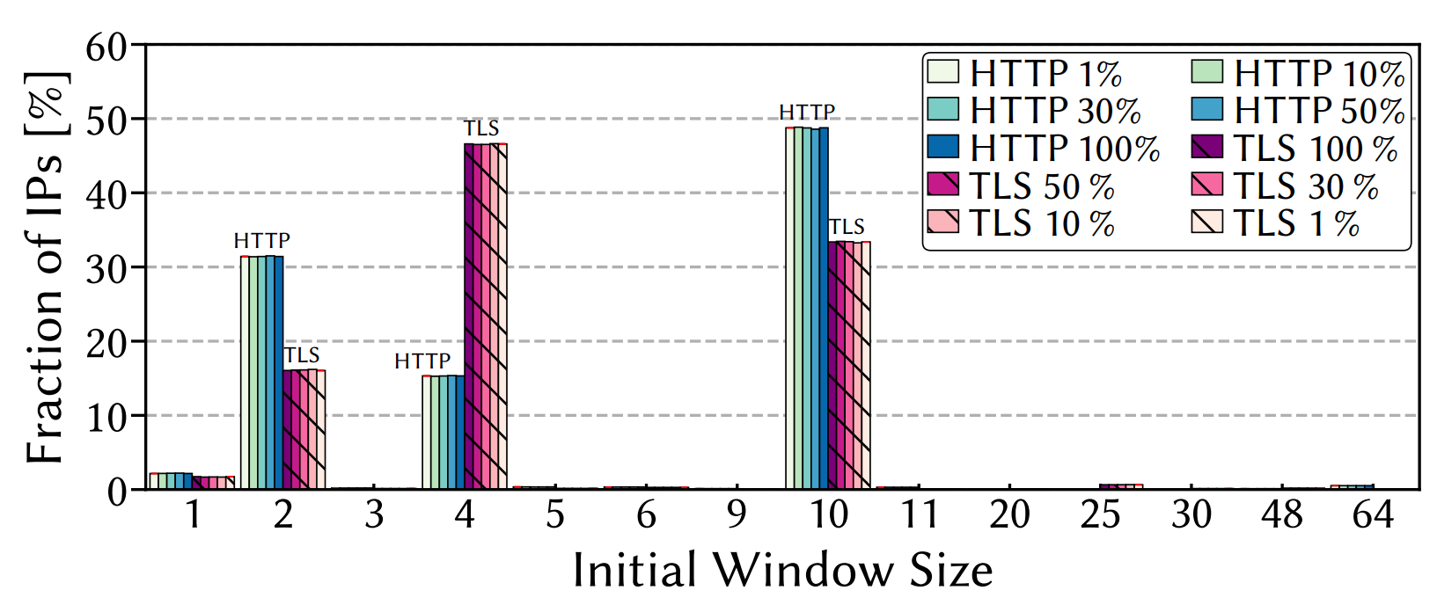
Initial Window Size
What should be the initial value of cwnd?
  Too small – flows take longer to leave slow start
  Too big – new flows create burst of traffic that may congest networks
Subject of ongoing debate
  E.g. Linux kernel officially adopted cwnd = 10 in 2011
What sizes are in use today?
Jan Rüth, Christian Bormann, Oliver Hohlfeld. Large-scale Scanning of TCP’s Initial Window. IMC 2017.

Slide 42
High Bandwidth-Delay Product
Key Problem: TCP performs poorly when
  The capacity of the network (bandwidth) is large, or
  The delay (RTT) of the network is large, or
  The bandwidth-delay product is large
Why does TCP perform poorly?
  Slow start and additive increase are slow to converge when bandwidth is large
  TCP is ACK clocked
    i.e., TCP can only react as quickly as ACKs are received
    Large RTT → ACKs are delayed → TCP is slow to react

Slide 43
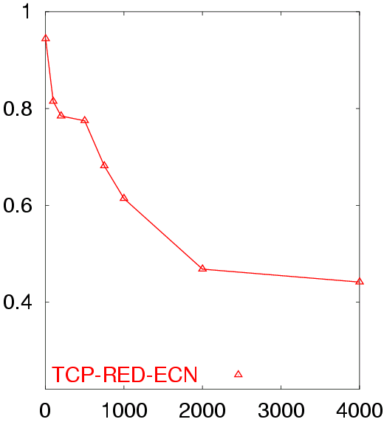
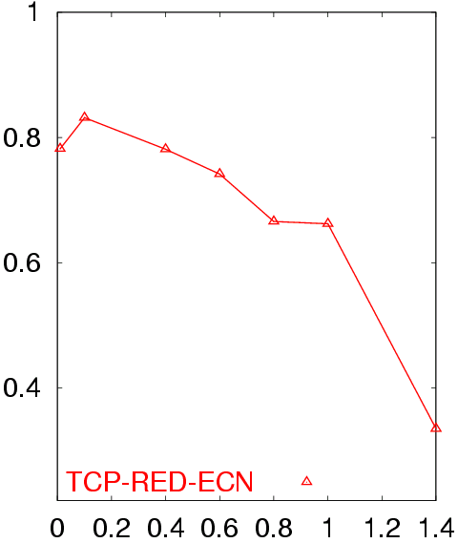
Poor Performance of TCP Reno
50 flows in both directions
Buffer = BW x Delay
RTT = 80 ms
50 flows in both directions
Buffer = BW x Delay
BW = 155 Mb/s
Avg. TCP Utilization
Avg. TCP Utilization
Bottleneck Bandwidth (Mb/s)
Round Trip Delay (sec)

Slide 44
How to Improve Utilization?
Fast window growth
  Slow start and additive increase are too slow when bandwidth is large
  Want to converge more quickly
Maintain fairness with other TCP variants
  Window growth cannot be too aggressive
Simple implementation

Slide 45
Compound TCP Implementation
Default TCP implementation in Windows
Key idea: split cwnd into two separate windows
  Traditional, loss-based window
  New, delay-based window
wnd = min(cwnd + dwnd, adv_wnd)
  cwnd is controlled by AIMD
  dwnd is the delay window
Rules for adjusting dwnd:
  If RTT is increasing, decrease dwnd (dwnd >= 0)
  If RTT is decreasing, increase dwnd
  Increase/decrease are proportional to the rate of change

Slide 46
Compound TCP Example
Faster cwnd growth
RTT
Increasing
RTT
Decreasing
Slower cwnd growth
Timeout
Timeout
cwnd
Slow Start
Time
Aggressiveness corresponds to changes in RTT
Advantages: fast ramp up, fairer to flows with different RTTs
Disadvantage: must estimate RTT, which is very challenging

Slide 47
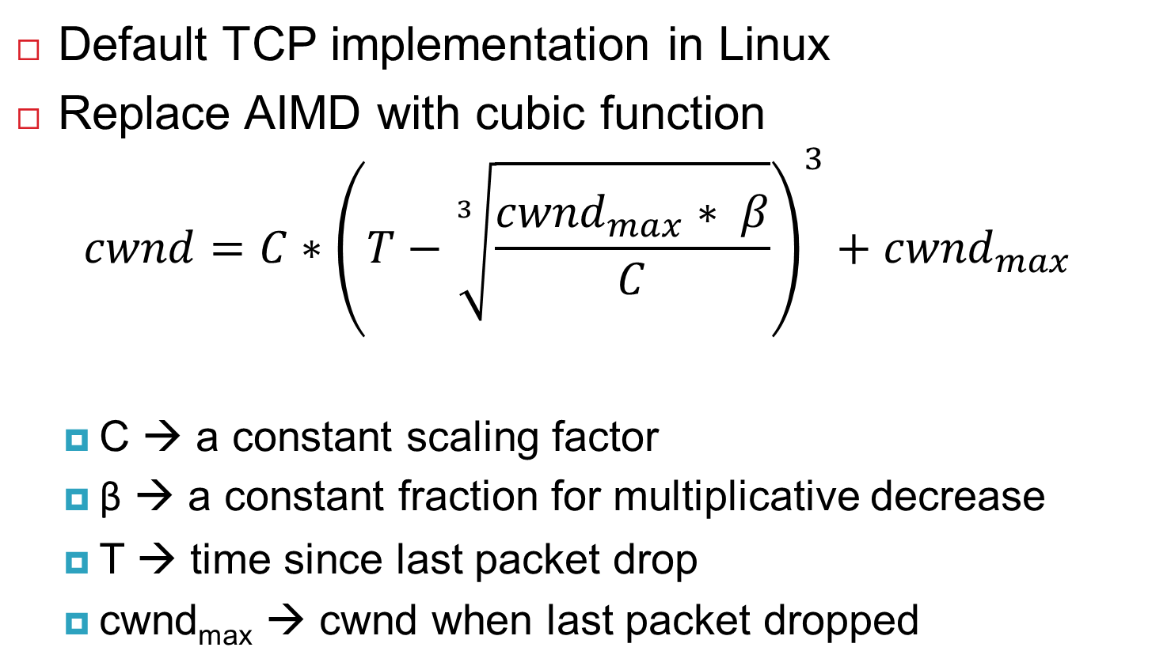
TCP CUBIC Implementation
Default TCP implementation in Linux
Replace AIMD with cubic function
$$cwnd=C∗{\left(T−\sqrt[3]{\frac{{cwnd}_{max}∗ β}{C}}\right)}^{3}+{cwnd}_{max}$$
  C → a constant scaling factor
  β → a constant fraction for multiplicative decrease
  T → time since last packet drop
  cwnd_{max} → cwnd when last packet dropped

Slide 48
TCP CUBIC Example
Slowly accelerate to probe for bandwidth
CUBIC Function
Timeout
cwnd_{max}
cwnd
Stable
Region
Slow Start
Fast ramp up
Time
Less wasted bandwidth due to fast ramp up
Stable region and slow acceleration help maintain fairness
  Fast ramp up is more aggressive than additive increase
  To be fair to Tahoe/Reno, CUBIC needs to be less aggressive

Slide 49
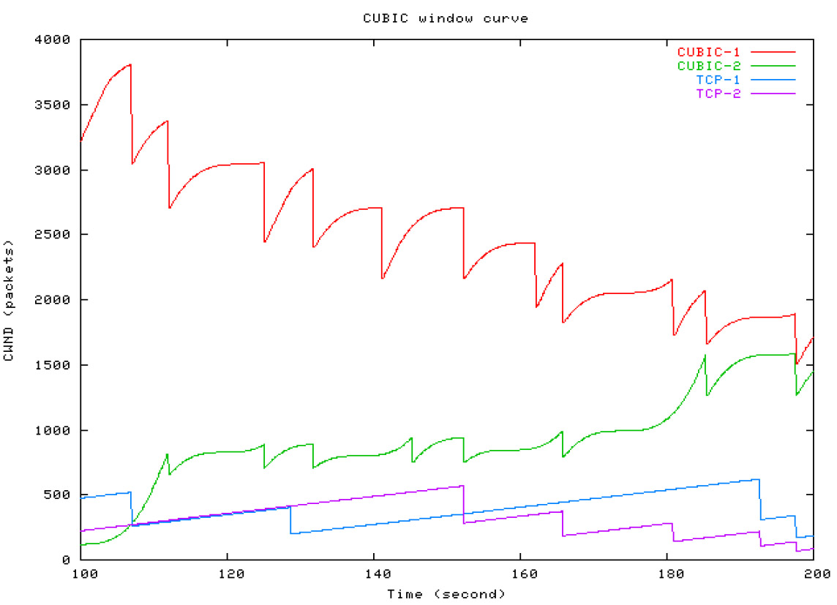
Simulations of TCP Flows
Unfairness between TCP variants that share a link
CUBIC is more aggressive, so obtains an unfair bandwidth share
CUBIC
CUBIC
Reno
Reno

Slide 50
Deploying TCP Variants
TCP assumes all flows employ TCP-like congestion control
  TCP-friendly or TCP-compatible
  Violated by UDP :(
If new congestion control algorithms are developed, they must be TCP-friendly
Be wary of unforeseen interactions
  Variants work well with others like themselves
  Different variants competing for resources may trigger unfair, pathological behavior

Slide 51
Outline
Congestion Basics
TCP Tahoe
TCP Reno
TCP Cubic
BBR

Slide 52
Issues with TCP
Most Internet traffic is TCP
However, many issues with the protocol
  Synchronization of flows
  Poor performance with small flows
  Problems on modern, high bandwidth-delay product networks
    Slow ramp-up when bandwidth is large, low utilization
  Lack of fairness when RTT varies across flows
  Poor performance on wireless networks, packet loss is assumed to be congestion
  Probing for bandwidth induces congestion and packet drops
  Susceptibility to denial of service
Random Early Drop/Detection in IP routers
Increase initial cwnd
CUBIC instead of AIMD

Slide 53


Fairness
Key problem: TCP throughput depends on RTT
100 ms
1 Mbps
1 Mbps
1 Mbps
1 Mbps
1 Mbps
1000 ms
ACK clocking makes TCP inherently unfair
Possible solution: explicitly take changes in delay (RTT) into account
  Implemented by Microsoft’s Compound TCP and Google’s BBR

Slide 54
Wireless Networks
Problem: Tahoe and Reno assume loss = congestion
  True on the WAN, bit errors are very rare
  False on wireless, interference is very common
TCP throughput ~ 1/sqrt(drop rate)
  Even a few interference drops can kill performance
Possible solutions:
  Break layering, push data link info up to TCP
  Explicit congestion notification (ECN)
    Routers mark the 1-bit ECN field in the TCP header to indicate congestion
  Use delay-based congestion detection (TCP Vegas, BBR)

Slide 55
TCP BBR
Motivation: Loss does not always imply congestion
Bottleneck Bandwidth and Round-trip (BBR)
Key idea: model the bottleneck bandwidth rate using two properties
  Bottleneck bandwidth
  Propagation RTT
Based on the model, vary:
  The congestion window size
  The sending rate, i.e., how quickly segments are transmitted
Developed by Google, beginning in 2016

Slide 56
TCP BBR v1 Goals
Don't overreact: don't do a multiplicative decrease on every round trip with loss/ECN
Probe robustly: try to probe beyond estimated max bandwidth before reducing the estimate
Grow scalably: start probing at 1 extra packet, grow exponentially to use free capacity
Loss != congestion, helps in wireless networks
Same as TCP Tahoe, Reno, Cubic
No additive increase; like slow start and CUBIC

Slide 57
TCP BBR v2 Goals
All v1 goals, plus…
Leave headroom: leave space for entering flows to grab
Probe deferentially: probe on a time scale to allow coexistence with Reno/CUBIC
Avoid overshooting: start probing at an inflight measured to be tolerable
React quickly: using loss/ECN, adapt to delivery process now to maintain flow balance
Fairness towards new flows
Fairness towards less aggressive TCP variants
BBR v1 did not consider drops as a congestion signal at all; too aggressive

Slide 58
Key idea: model the bottleneck bandwidth rate using two properties
  Bottleneck bandwidth (btlBw)
  Propagation RTT (RTprop)
  Bandwidth Delay Product (BDP) = btlBw × Rtprop
Measuring btlBw
  Finds maximum observed delivery rate over past 10 RTTs
  Periodically increases send rate to 1.25 × btlBw to search for more bandwidth
Measuring Rtprop
  Finds minimum RTT over past 10 seconds based on ACKs
  Problem: BBR may induce queueing delays by sending to fast
  Solution: periodically “drain” queues by sending at 25% less than btlBw
Send data so that one BDP of data is in flight at a time
  Send rate (pacing) limited by cwnd or pacing_rate (pacing_gain × btlBw)
  cwnd capped to 2 × BDP (to overcome delays in received acks)

Slide 59
TCP BBR Example
RTT
Incr.
RTT
Decr.
PROBE_BW
Bottleneck
Bandwidth
Sending Rate
Bottleneck
Bandwidth
DRAIN
PROBE_RTT
STARTUP
Time

Slide 60
BBR Outperforms CUBIC in the WAN
https://www.ietf.org/proceedings/97/slides/slides-97-iccrg-bbr-congestion-control-02.pdf

Slide 61
Enable BBR For Yourself
On Linux, edit /etc/sysctl.conf and add:
    net.core.default_qdisc=fq
    net.ipv4.tcp_congestion_control=bbr
Run sysctl –p to reload the config
Check that it worked by running sysctl net.ipv4.tcp_congestion_control

Slide 62
Outline
Bonus: SYN Cookies

Slide 63
Denial of Service
Problem: TCP connections require state
  Initial SYN allocates resources on the server
  State must persist for several minutes (RTO)
SYN flood: send enough SYNs to a server to allocate all memory/meltdown the kernel
Solution: SYN cookies
  Idea: don’t store initial state on the server
  Securely insert state into the SYN/ACK packet
  Client will reflect the state back to the server

Slide 64
SYN Cookies
0
5
8
31
Sequence Number
Timestamp
MSS
Crypto Hash of Client IP & Port
Did the client really send me a SYN recently?
  Timestamp: freshness check
  Cryptographic hash: prevents spoofed packets
Maximum segment size (MSS)
  Usually stated by the client during initial SYN
  Server should store this value…
  Reflect the clients value back through them

Slide 65
SYN Cookies in Practice
Advantages
  Effective at mitigating SYN floods
  Compatible with all TCP versions
  Only need to modify the server
  No need for client support
Disadvantages
  MSS limited to 3 bits, may be smaller than clients actual MSS
  Server forgets all other TCP options included with the client’s SYN
    SACK support, window scaling, etc.

